Slide 1



Accelerating Genome Sequence Analysis via Efficient Hardware/Algorithm Co-Design
Damla Senol Cali
Staff Software Engineer, Hardware Acceleration
Bionano Genomics
Email: damlasenolcali@gmail.com
Website: https://damlasenolcali.github.io
SAFARI Live Seminar
November 7, 2021
Notes:
Hello, I am Damla Senol Cali. Thank you so much for joining to my talk!
I am a Staff Software Engineer, Hardware Acceleration at Bionano Genomics. I received my Ph.D. degree in Computer Engineering from the SAFARI Research Group at Carnegie Mellon University in August this year, where I was advised by Prof. Onur Mutlu and Prof. Saugata Ghose.
And today, I'll be discussing some of the work I did during my PhD on ”Accelerating Genome Sequence Analysis via Efficient Hardware/Algorithm Co-Design".

Slide 2
Genome Sequencing
Genome sequencing: Enables us to determine the order of the DNA sequence in an organism’s genome
Plays a pivotal role in:
Personalized medicine
Outbreak tracing
Understanding of evolution
Challenges:
There is no sequencing machine that takes long DNA as an input, and gives the complete sequence as output
Sequencing machines extract small randomized fragments of the original DNA sequence
Notes:
[CLICK] Genome sequencing, which enables us to determine the DNA sequence of an organism, [CLICK] plays a pivotal role in areas such as personalized medicine, outbreak tracing (like COVID-19), and the understanding of evolution.
However, there is no …

Slide 3
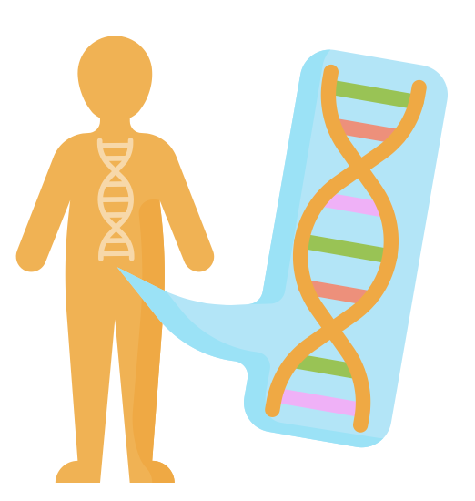




Genome Sequencing (cont’d.)
Chopped DNA
fragments
Sequenced reads
Sample Collection
Sequencing
Large DNA
molecule
Preparation
Genome Sequence Analysis

Slide 4
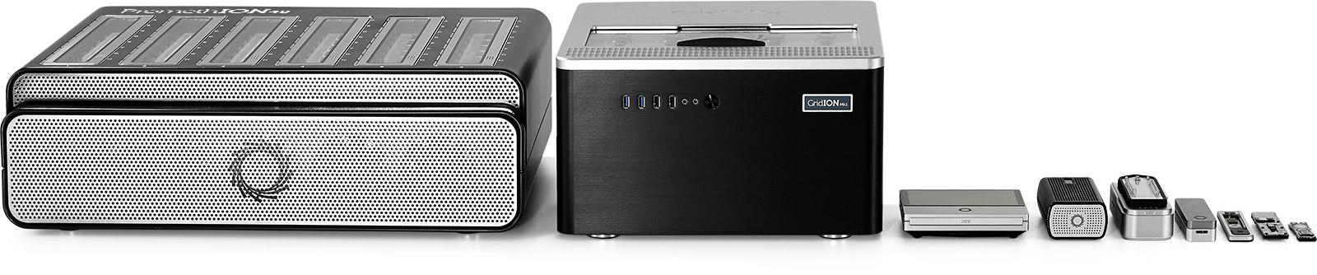
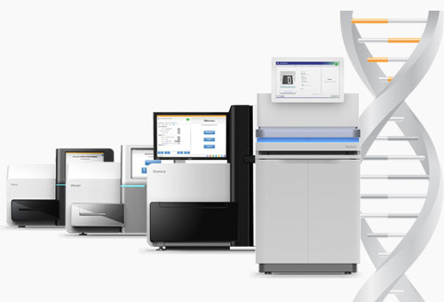
Sequencing Technologies
Oxford Nanopore (ONT)
PacBio
Illumina
Short reads: a few hundred base pairs and error rate of ∼0.1%
Long reads: thousands to millions of base pairs and error rate of 5–10%
Notes:
ONT, PacBio, Illumina
[CLICK] Based on the sequencing device, we obtain either short reads or long reads.

Slide 5
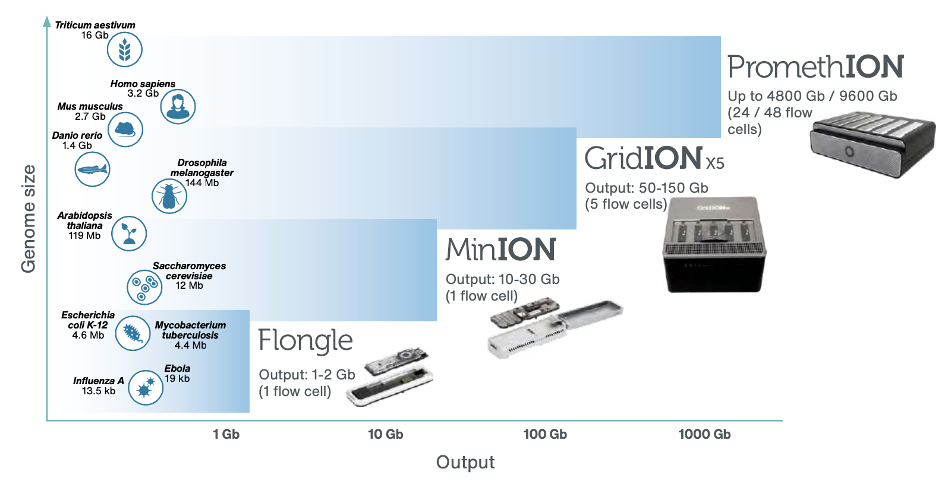
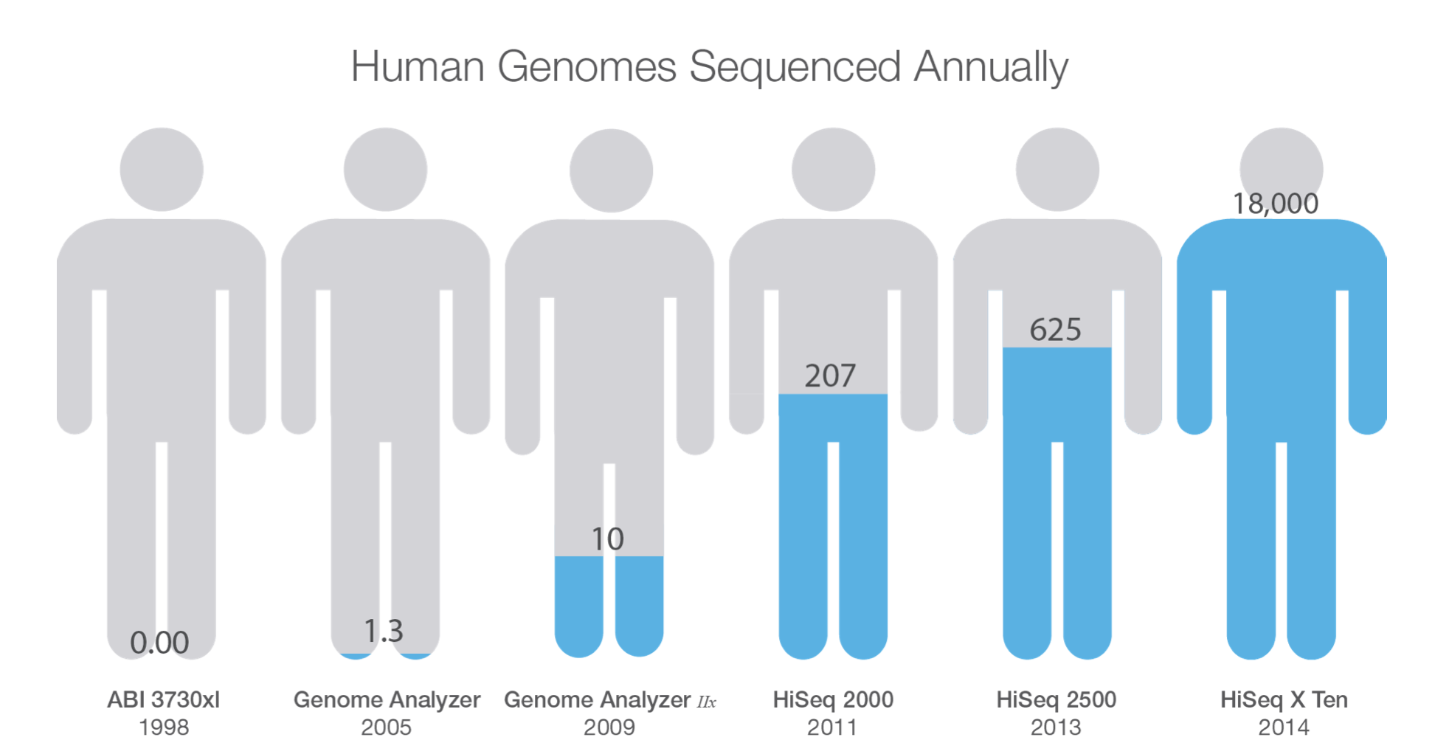
Current State of Sequencing
Notes:
As the sequencing devices become cheaper and more accessible, the amount of genomics data that is generated gets much higher.

Slide 6
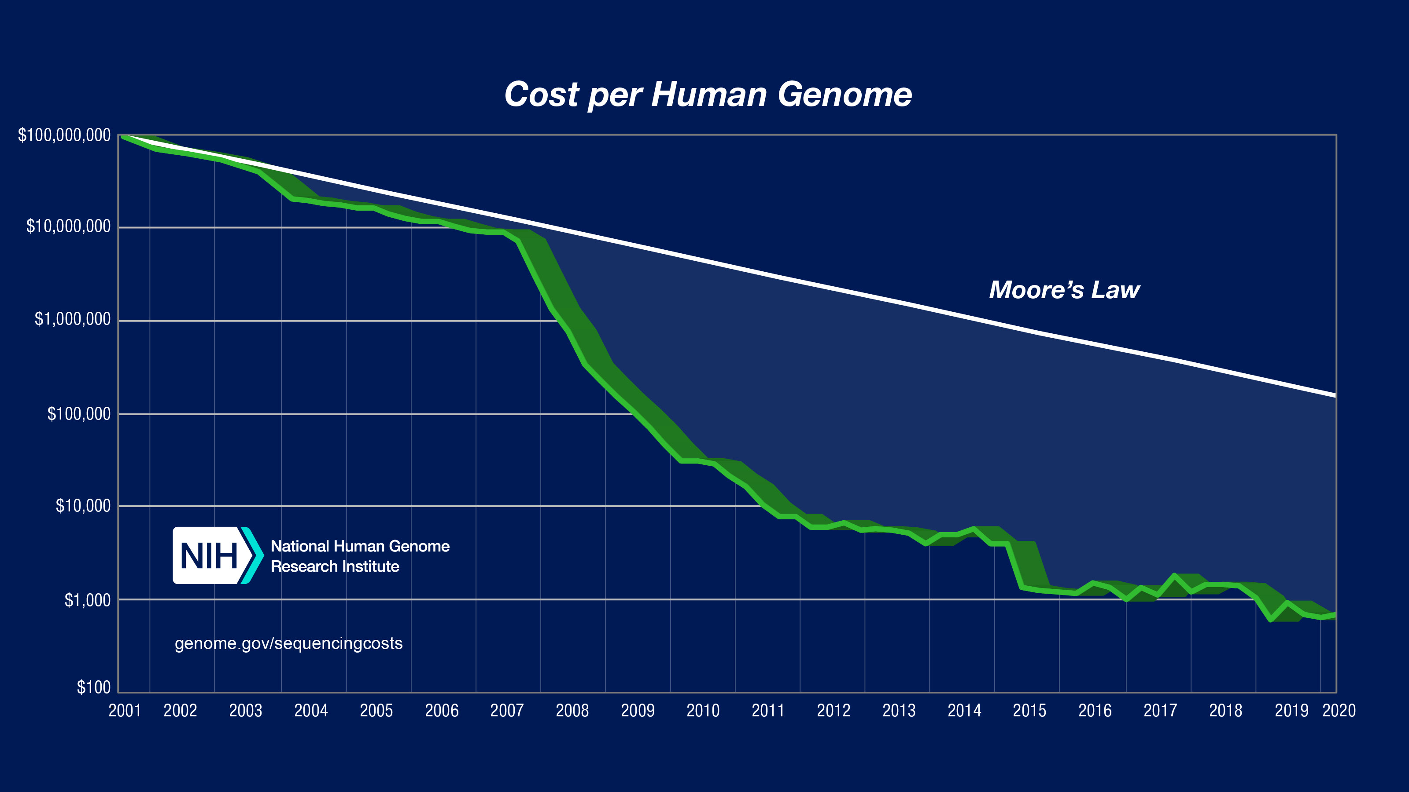
Current State of Sequencing (cont’d.)
*From NIH (https://www.genome.gov/about-genomics/fact-sheets/DNA-Sequencing-Costs-Data)
Notes:
However, the compute power doesn’t match up with this trend.
Modern sequencing machines generate read fragments at an exponentially higher rate than prior sequencing technologies, with their growth far outpacing the growth in computational power in recent years
For example, the Illumina NovaSeq 6000 system can sequence about 48 human whole genomes at 30× genome coverage (the av- erage number of times a genomic base is sequenced) in about two days. However, analyzing (performing mapping and variant calling) the sequencing data of a single human genome requires over 32 CPU hours on a 48-core Intel Xeon processor, 23 of which are spent on read mapping

Slide 7
Current State of Sequencing (cont’d.)
Computation is a bottleneck!
*From NIH (https://www.genome.gov/about-genomics/fact-sheets/DNA-Sequencing-Costs-Data)
Notes:
However, the compute power doesn’t match up with this trend.
Modern sequencing machines generate read fragments at an exponentially higher rate than prior sequencing technologies, with their growth far outpacing the growth in computational power in recent years
For example, the Illumina NovaSeq 6000 system can sequence about 48 human whole genomes at 30× genome coverage (the av- erage number of times a genomic base is sequenced) in about two days. However, analyzing (performing mapping and variant calling) the sequencing data of a single human genome requires over 32 CPU hours on a 48-core Intel Xeon processor, 23 of which are spent on read mapping

Slide 8
Problem Statement
Rapid genome sequence analysis is currently bottlenecked by the computational power and memory bandwidth limitations of
existing systems, as many of the steps
in genome sequence analysis must process
a large amount of data
Notes:
However,

Slide 9
Our Goal & Approach
Our Goal:
Accelerating genome sequence analysis by efficient hardware/algorithm co-design
Our Approach:
Analyze the multiple steps and the associated tools in the genome sequence analysis pipeline,
Expose the tradeoffs between accuracy, performance, memory usage and scalability, and
Co-design fast and efficient algorithms along with scalable and energy-efficient customized hardware accelerators for the key bottleneck steps of the pipeline
Notes:
To this end, our goal is to accelerate …
We need to (1) understand where the current tools and algorithms do not perform well in order to develop better tools and algorithms, and (2) understand the limitations of existing hardware systems when running these tools and algorithms in order to design efficient customized accelerators.
Thus, our approach is to first, ...

Slide 10
Research Statement
Genome sequence analysis
can be accelerated by co-designing
fast and efficient algorithms along with scalable and energy-efficient customized hardware accelerators for the
key bottleneck steps of the pipeline
Notes:
My research statement is as follows:

Slide 11
Research Contributions
Bottleneck analysis of genome assembly pipeline for long reads
[Briefings in Bioinformatics, 2018]
GenASM: Approximate string matching framework for
genome sequence analysis
[MICRO 2020]
BitMAc: FPGA-based near-memory acceleration of
bitvector-based sequence alignment
[Ongoing]
SeGraM: Hardware acceleration framework for
sequence-to-graph mapping
[Ongoing]
Notes:
Towards this end, we propose four major works.
First, we comprehensively analyze the tools in the genome assembly pipeline for long reads in multiple dimensions, uncovering bottlenecks and tradeoffs that different combinations of tools and different underlying systems lead to. We show that we need high-performance, memory-efficient, low-power, and scalable designs for genome sequence analysis in order to exploit the advantages that genome sequencing provides.
Second, we propose GenASM, an acceleration framework that builds upon bitvector-based approximate string matching (ASM) to accelerate multiple steps of the genome sequence analysis pipeline.
Third, we implement an FPGA-based prototype for GenASM, where state-of-the-art 3D-stacked memory (HBM2) offers high memory bandwidth and FPGA resources offer high parallelism by instantiating multiple copies of the GenASM accelerators.
Fourth, we propose SeGraM, the first hardware acceleration framework for sequence-to-graph mapping. SeGraM enables the efficient mapping of a sequenced genome to a graph-based reference, providing more comprehensive and accurate genome sequence analysis. Compared to single linear references, genome graphs provide a better representation of the diversity among populations by encoding variations across individuals in a graph data structure, avoiding a bias towards any one reference.

Slide 12
Research Contributions
Bottleneck analysis of genome assembly pipeline for long reads
[Briefings in Bioinformatics, 2018]
GenASM: Approximate string matching framework for
genome sequence analysis
[MICRO 2020]
BitMAc: FPGA-based near-memory acceleration of
bitvector-based sequence alignment
[Ongoing]
SeGraM: Hardware acceleration framework for
sequence-to-graph mapping
[Ongoing]
Notes:
Let’s start with the first work.

Slide 13
Genome Sequence Analysis
ACGTACCCCGT
TTTTTTTAATT
ACGAGCGGGT
GATACACTGTG
AAAAAAAAAA
Reads
CTAGGGACCTT
ACGACGTAGCT
Read Mapping, method of aligning the reads against the reference genome in order to detect matches and variations.
De novo Assembly, method of merging the reads in order to construct the original sequence.
Reference
Genome
Original
Sequence
Reads
Mapped Reads
Reads
Assembled Reads
Notes:
When I say analysis, what do I mean. What I mean is how we will analyze these reads.
They can then be analyzed following two different approaches:
First one is Read mapping and it is the process of aligning the reads against the reference genome to detect sequencing errors and variations in the sequenced genome.
And the second approach is de novo assembly, which is the method of combining the reads to construct the original sequence when a reference genome does not exist.

Slide 14
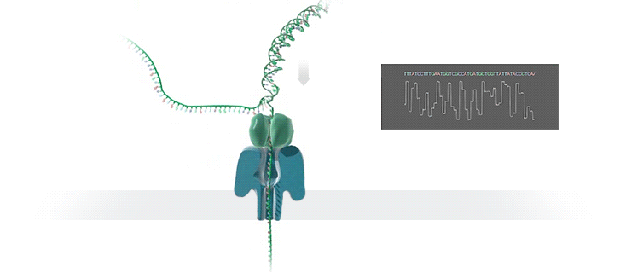
Genome Assembly Pipeline Using Long Reads
With the emergence of long read sequencing technologies, de novo assembly becomes a promising way of constructing the original genome.
Raw signal data
Basecalling
(Translates signal data into bases: A,C,G,T)
DNA reads
Read-to-Read Overlap Finding
(Finds pairwise read alignments for each pair of read)
Overlaps
Assembly
Assembly
(Traverses the overlap graph & constructs the draft assembly)
Draft assembly
Read Mapping
(Maps the reads to the draft assembly)
Mappings of reads against draft assembly
Improved assembly
Polishing
(Polishes the draft assembly & increases the accuracy)
Notes:
With the emergence of long read sequencing technologies (i.e., ONT and PacBio), de novo assembly becomes a promising way of constructing the original genome since a long read can span an entire repetitive sequence and enable continuous and complete assemblies.
The output of nanopore sequencers is raw signal data that represents changes in electric current when a DNA strand passes through nanopore. Thus, the pipeline starts with the raw signal data. The first step, basecalling, translates this raw signal output of MinION into bases (A, C, G, T) to generate DNA reads. It is important to note that basecalling is the only step unique to nanopore sequencing, and the rest of the steps are applicable for both of the long read sequencing technologies (ONT and PacBio).
The second step computes all pairwise read alignments between each pair of reads, called read-to-read overlaps. The third pipeline step, genome assembly, generates an overlap graph, where each node denotes a read and each edge represents the overlaps between the corresponding two nodes. Then it traverses this overlap graph, produces the layout of the reads and then constructs a draft assembly. To increase the accuracy of the assembly, further polishing, i.e., post-assembly error correction, may be required, but it is optional. The fourth step of the pipeline is mapping the original basecalled reads to the generated draft assembly from the previous step (i.e., read mapping). The fifth and final step of the pipeline is polishing the assembly with the help of mappings from the previous step.

Slide 15
Our Contributions
Analyze the tools in multiple dimensions: accuracy, performance, memory usage, and scalability
Reveal new bottlenecks and trade-offs
First study on bottleneck analysis of nanopore sequence analysis pipeline on real machines
Provide guidelines for practitioners
Provide guidelines for tool developers
Notes:
In this work, we analyze the tools associated with the multiple steps in the genome assembly pipeline using nanopore sequence data in terms of accuracy, speed, memory efficiency and scalability.
Reveal bottlenecks and trade-offs that different combinations of tools and different underlying systems lead to
This is the first study on bottleneck analysis of nanopore sequence analysis pipeline on real machines
Provide guidelines for practitioners, such that they can determine the appropriate tools and tool combinations that can satisfy their goals, and
Provide guidelines for tool developers, such that they can make design choices to improve current and future tools.

Slide 16
Key Findings
Laptops are becoming a popular platform for running genome assembly tools, as the portability of a laptop makes it a good fit for in-field analysis
Greater memory constraints
Lower computational power
Limited battery life
Memory usage is an important factor that greatly affects the performance and the usability of the tool
Data structure choices that increase the memory requirements
Algorithms that are not cache-efficient
Not keeping memory usage in check with the number of threads
Scalability of the tool with the number of cores is an important requirement. However, parallelizing the tool can increase the memory usage
Not dividing the input data into batches
Not limiting the memory usage of each thread
Dividing the dataset instead of the computation between simultaneous threads
Notes:
We have 21 observations in our paper, but let me highlight 3 key findings we made
Laptops are becoming a popular platform for running genome assembly tools, as the portability of a laptop makes it a good fit for in-field analysis
Greater memory constraints,
Lower computational power, and
Limited battery life
Memory usage is an important factor that greatly affects the performance and the usability of the tool
Data structure choices that can minimize the memory requirements
Cache-efficient algorithms
Keeping memory usage in check with the number of threads
Scalability of the tool with the number of cores/threads is an important requirement.
However, parallelizing the tool can increase the memory usage.
Dividing the input data into batches
Limiting the memory usage of each thread
Dividing the computation instead of the dataset between simultaneous threads

Slide 17
Key Findings
Goal 1:
High-performance and low-power
Laptops are becoming a popular platform for running genome assembly tools, as the portability of a laptop makes it a good fit for in-field analysis
Greater memory constraints,
Lower computational power
Limited battery life
Memory usage is an important factor that greatly affects the performance and the usability of the tool
Data structure choices that increase the memory requirements
Algorithms that are not cache-efficient
Not keeping memory usage in check with the number of threads
Scalability of the tool with the number of cores is an important requirement. However, parallelizing the tool can increase the memory usage
Not dividing the input data into batches
Not limiting the memory usage of each thread
Dividing the dataset instead of the computation between simultaneous threads

Slide 18
Key Findings
Goal 1:
High-performance and low-power
Laptops are becoming a popular platform for running genome assembly tools, as the portability of a laptop makes it a good fit for in-field analysis
Greater memory constraints,
Lower computational power
Limited battery life
Memory usage is an important factor that greatly affects the performance and the usability of the tool
Data structure choices that can minimize the memory requirements
Cache-efficient algorithms
Keeping memory usage in check with the number of threads
Scalability of the tool with the number of cores is an important requirement. However, parallelizing the tool can increase the memory usage
Not dividing the input data into batches
Not limiting the memory usage of each thread
Dividing the dataset instead of the computation between simultaneous threads
Goal 2:
Memory-efficient

Slide 19
Key Findings
Goal 1:
High-performance and low-power
Laptops are becoming a popular platform for running genome assembly tools, as the portability of a laptop makes it a good fit for in-field analysis
Greater memory constraints,
Lower computational power
Limited battery life
Memory usage is an important factor that greatly affects the performance and the usability of the tool
Data structure choices that can minimize the memory requirements
Cache-efficient algorithms
Keeping memory usage in check with the number of threads
Scalability of the tool with the number of cores is an important requirement. However, parallelizing the tool can increase the memory usage.
Dividing the input data into batches
Limiting the memory usage of each thread
Dividing the computation instead of the dataset between simultaneous threads
Goal 2:
Memory-efficient
Goal 3:
Scalable/highly-parallel

Slide 20
Nanopore Sequencing & Tools [BiB 2018]
Damla Senol Cali, Jeremie S. Kim, Saugata Ghose, Can Alkan, and Onur Mutlu,
"Nanopore Sequencing Technology and Tools for Genome Assembly: Computational Analysis of the Current State, Bottlenecks and Future Directions"
Briefings in Bioinformatics, April 2018.
Notes:
For all other observations, you can refer to our paper.

Slide 21
Research Contributions
Bottleneck analysis of genome assembly pipeline for long reads
[Briefings in Bioinformatics, 2018]
GenASM: Approximate string matching framework for
genome sequence analysis
[MICRO 2020]
BitMAc: FPGA-based near-memory acceleration of
bitvector-based sequence alignment
[Ongoing]
SeGraM: Hardware acceleration framework for
sequence-to-graph mapping
[Ongoing]
Notes:
to meet the three goals that we discussed, we need to co-design the HW and SW
low-power + high-performance
memory-efficiency
high parallelism

Slide 22
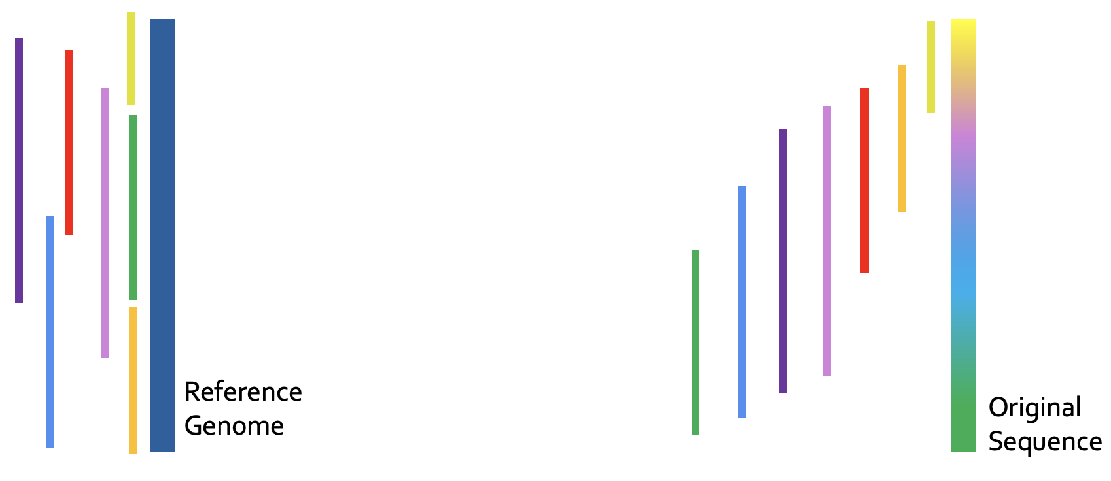
Recall: Genome Sequence Analysis
ACGTACCCCGT
TTTTTTTAATT
ACGAGCGGGT
GATACACTGTG
AAAAAAAAAA
Reads
CTAGGGACCTT
ACGACGTAGCT
Read Mapping, method of aligning the reads against the reference genome in order to detect matches and variations.
De novo Assembly, method of merging the reads in order to construct the original sequence.
Notes:
As I mentioned, read mapping is one of the steps of the assembly pipeline.
However, if you remember, read mapping is also another main approach to perform GSA. And it is a very commonly used pipeline, and one of the very common downstream analysis after read mapping is variant calling.

Slide 23
Read Mapping Pipeline
Reference genome
Indexing
(Pre-processing step to generate index of reference)
Hash-table based index
Reads
Seeding
(Query the index)
Potential mapping
locations
Reference
segment
Pre-Alignment Filtering
(Filter out dissimilar sequences)
Query read
Remaining potential mapping locations
Read Alignment
(Perform distance/score calculation & traceback)
Optimal alignment
Notes:
Let’s look at the read mapping pipeline. Read mapping can be seen as a four-step process (i.e., seed-and-extend).
First, read mapping starts with indexing the reference genome. This index contains all possible fixed-length substrings as the keys, and the exact match locations of these substrings in the reference genome as values. Second, seeding queries the index structure for determining potential mapping locations of each read in the reference genome using substrings (i.e., seeds) from each read.
Third, pre-alignment filtering uses filtering heuristics to examine the similarity between every read and its potential matching segment on the reference genome that are identified in the second step. Goal is to eliminate most of the dissimilar sequences to decrease the number of required alignments. Fourth, for all of the non-filtered candidate mapping locations, read alignment (i.e., seed-extension) step performs a dynamic programming based alignment to determine the best location of the query read. As part of this step, traceback operation between the reference segment and the query is performed in order to find the optimal alignment.

Slide 24
GSA with Read Mapping
Read mapping: First key step in genome sequence analysis (GSA)
Aligns reads to one or more possible locations within the reference genome, and
Finds the matches and differences between the read and the reference genome segment at that location
Multiple steps of read mapping require approximate string matching
Approximate string matching (ASM) enables read mapping to account for sequencing errors and genetic variations in the reads
Bottlenecked by the computational power and memory bandwidth limitations of existing systems
Notes:
[CLICK] In read mapping, we take each read, align it to one or more possible locations within the reference genome, and find the matches and differences between the read and the reference genome segment at that location.
[CLICK] Multiple steps of read mapping must account for the sequencing errors, and for the differences caused by genetic variations. As a result, read mapping must perform approximate string matching (ASM).
[CLICK] However, it is one of the main contributors of the computational power and memory bandwidth limitations of existing systems bottleneck.

Slide 25
GenASM: ASM Framework for GSA
Our Goal:
Accelerate approximate string matching
by designing a fast and flexible framework,
which can accelerate multiple steps of genome sequence analysis
GenASM: First ASM acceleration framework for GSA
Based upon the Bitap algorithm
Uses fast and simple bitwise operations to perform ASM
Modified and extended ASM algorithm
Highly-parallel Bitap with long read support
Novel bitvector-based algorithm to perform traceback
Co-design of our modified scalable and memory-efficient algorithms with low-power and area-efficient hardware accelerators
Notes:
[CLICK] Our goal in this work is to design a fast and flexible framework for both short and long reads, which can accelerate multiple steps of genome sequence analysis (GSA).
[CLICK] To this end, we propose GenASM.
[CLICK] We base GenASM on Bitap, an ASM algorithm that uses only fast and simple bitwise operations, making it amenable to efficient hardware acceleration. To our knowledge, GenASM is the first work that enhances and accelerates Bitap.
[CLICK] We modify Bitap to support long reads and to enable parallelization.
We also develop a novel Bitap-compatible algorithm for traceback
[CLICK] And, we co-design specialized hardware for both algorithms.

Slide 26
Approximate String Matching
Sequenced genome may not exactly map to the reference genome due to genetic variations and sequencing errors
Approximate string matching (ASM):
Detect the differences and similarities between two sequences
In genomics, ASM is required to:
Find the minimum edit distance (i.e., total number of differences)
Find the optimal alignment with a traceback step
Sequence of matches, substitutions, insertions and deletions, along with their positions
Usually implemented as a dynamic programming (DP) based algorithm
Reference:
Read:
AAAATGTTTAGTGCTACTG
AAAATGTTTACTGCTACTTG
AAAATGTTTAGTGCTACTG
AAATGTTTACTGCTACTTG
AAAATGTTTAGTGCTACTTG
AAAATGTTTAGTGCTACTTG
AAAATGTTTAGTGCTACTG
AAAATGTTTAGTGCTACTTG
A
G
C
T
deletion
substitution
insertion
Notes:
Let’s look at approximate string matching and the bitap algorithm in detail.
As I introduced, the reads may not exactly map to the reference genome due to genetic variations and sequencing errors.
[CLICK] As we can see from this example, these errors and differences (which are also known as edits) can take the form of base [CLICK] deletions, [CLICK] substitutions and [CLICK] insertions.
[CLICK] So we need approximate string matching (ASM).
[CLICK] The goal of approximate string matching is to detect these differences and similarities between two sequences.
[CLICK] In genomics, ASM is required
[CLICK] (1) to determine the minimum number of edits between two genomic sequences (which is called edit distance), and also
[CLICK] (2) to find the optimal alignment with a traceback step., where we find the sequence of matches, substitutions, insertions and deletions, along with their positions.

Slide 27
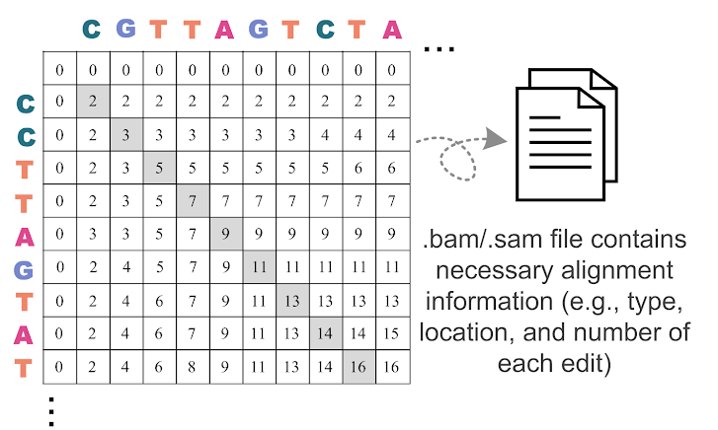
DP-based ASM
Commonly-used algorithm for ASM in genomics…
...with quadratic time and space complexity
Notes:
[CLICK] Approximate string matching is typically implemented as a dynamic programming based algorithm, which has quadratic time and space complexity. Therefore, it is desirable to find lower-complexity algorithms for ASM.

Slide 28
Bitap Algorithm
Bitap^{1,2} performs ASM with fast and simple bitwise operations
Amenable to efficient hardware acceleration
Computes the minimum edit distance between a text (e.g., reference genome) and a pattern (e.g., read) with a maximum of k errors
Step 1: Pre-processing (per pattern)
Generate a pattern bitmask (PM) for each character in the alphabet (A, C, G, T)
Each PM indicates if character exists at each position of the pattern
Step 2: Searching (Edit Distance Calculation)
Compare all characters of the text with the pattern by using:
Pattern bitmasks
Status bitvectors that hold the partial matches
Bitwise operations
[1] R. A. Baeza-Yates and G. H. Gonnet. "A New Approach to Text Searching." CACM, 1992.
[2] S. Wu and U. Manber. "Fast Text Searching: Allowing Errors." CACM, 1992.
Notes:
[CLICK] One candidate to replace DP-based algorithms for ASM is the Bitap algorithm. Bitap uses only fast and simple bitwise operations to perform ASM, making it amenable to efficient hardware acceleration.
[CLICK] Bitap tackles the problem of computing the minimum edit distance between a reference text (e.g., reference genome) and a query pattern (e.g., read) with a maximum of k errors.
The algorithm has two steps. [CLICK]
Bitap starts with a pre-processing procedure
[CLICK] where we generate one pattern bitmask for each character in the alphabet. These pattern bitmasks help us to represent the query pattern in a binary format.
Second step (searching or edit distance calculation) is the main step of the algorithm. Here, [CLICK] we examine each text character one by one, by using
[CLICK] 1) the pre-processed pattern bitmasks,
[CLICK] 2) status bitvectors which are updated at each text iteration and hold the partial match information for the text characters examined so far, and
[CLICK] 3) the simple bitwise operations.

Slide 29
Limitations of Bitap
Data Dependency Between Iterations:
Two-level data dependency forces the consecutive iterations to take place sequentially
Notes:
We find that Bitap has five limitations that hinder its applicability and efficient hardware acceleration for genome sequence analysis.
Let’s look at the first one, which is data dependency between large number of iterations

Slide 30
Bitap Algorithm (cont’d.)
Step 2: Edit Distance Calculation
For each character of the text (char):
Copy previous R bitvectors as oldR
R[0] = (oldR[0] << 1) | PM [char]
For d = 1…k:
deletion = oldR[d-1]
substitution = oldR[d-1] << 1
insertion = R[d-1] << 1
match = (oldR[d] << 1) | PM [char]
R[d] = deletion & mismatch & insertion & match
Check MSB of R[d]:
If 1, no match.
If 0, match with d many errors.
Large number of iterations
Notes:
First, Bitap iterates over each text character as the outer loop and it iterates over each possible edit distance (1 to k) as the inner loop.
Thus, when we have long error-prone reads, both of these loops need to iterate over very large numbers.

Slide 31
Bitap Algorithm (cont’d.)
Step 2: Edit Distance Calculation
For each character of the text (char):
Copy previous R bitvectors as oldR
R[0] = (oldR[0] << 1) | PM [char]
For d = 1…k:
deletion = oldR[d-1]
substitution = oldR[d-1] << 1
insertion = R[d-1] << 1
match = (oldR[d] << 1) | PM [char]
R[d] = deletion & mismatch & insertion & match
Check MSB of R[d]:
If 1, no match.
If 0, match with d many errors.
Data dependency between iterations (i.e., no parallelization)
Notes:
On top of this, There is two-level data dependency in Bitap.
[CLICK] There is an outer loop data dependency when computing deletion, substitution and match bitvectors as they require oldR bitvectors which are coming from previous text iteration.
[CLICK] Also, there is an inner loop data dependency when computing insertion bitvector as it requires R[d-1] which is coming from previous inner loop iteration.

Slide 32
Limitations of Bitap
Data Dependency Between Iterations:
Two-level data dependency forces the consecutive iterations to take place sequentially
No Support for Traceback:
Bitap does not include any support for optimal alignment identification
Notes:
Let’s look at the second limitation of Bitap, which is no support for traceback.

Slide 33
Bitap Algorithm (cont’d.)
Step 2: Edit Distance Calculation
For each character of the text (char):
Copy previous R bitvectors as oldR
R[0] = (oldR[0] << 1) | PM [char]
For d = 1…k:
deletion = oldR[d-1]
substitution = oldR[d-1] << 1
insertion = R[d-1] << 1
match = (oldR[d] << 1) | PM [char]
R[d] = deletion & mismatch & insertion & match
Check MSB of R[d]:
If 1, no match.
If 0, match with d many errors.
Does not store and process these intermediate bitvectors to find the optimal alignment (i.e., no traceback)
Notes:
Bitap generates the four intermediate bitvectors but they are not stored and processed with a traceback step to find the optimal alignment

Slide 34
Limitations of Bitap
Algorithm
Data Dependency Between Iterations:
Two-level data dependency forces the consecutive iterations to take place sequentially
No Support for Traceback:
Bitap does not include any support for optimal alignment identification
No Support for Long Reads:
Each bitvector has a length equal to the length of the pattern
Bitwise operations are performed on these bitvectors
Limited Compute Parallelism:
Text-level parallelism
Limited by the number of compute units in existing systems
Limited Memory Bandwidth:
High memory bandwidth required to read and write the computed bitvectors to memory
Hardware
Notes:
[CLICK] We find one more algorithmic limitation, which is no support for long reads. In Bitap, the query length so read length is limited by the word size of the machine running the algorithm because each bitvector has a length equal to the length of the pattern and we perform the bitwise operations on these bitvectors. Thus, the algorithm does not support long reads, whose lengths are on the order of thousands to millions of base pairs
[CLICK] These are the algorithmic limitations of the Bitap algorithm.
Even after we solve the algorithmic limitations of Bitap, we find that we cannot extract significant performance benefits with algorithmic enhancements alone.
[CLICK] 4) For example, while Bitap iterates over each character of the input text sequentially, we can enable text-level parallelism to improve its performance. However, the achievable level of parallelism is limited by the number of compute units in existing systems.
5) We would expect that a GPU, which has thousands of compute units, can overcome the limited compute parallelism issues that CPUs experience. [CLICK] However, we find that a GPU implementation of the Bitap algorithm suffers from the limited amount of memory bandwidth available for each GPU thread.
[CLICK] And these are the HW-related limitations.
In order to overcome these limitations and design an efficient accelerator, we find that we need to both (1) modify and extend the Bitap algorithm and (2) develop specialized hardware that can exploit the new opportunities that our algorithmic modifications provide.

Slide 35
GenASM: ASM Framework for GSA
Approximate string matching (ASM) acceleration framework based on the Bitap algorithm
First ASM acceleration framework for genome sequence analysis
We overcome the five limitations that hinder Bitap’s use in genome sequence analysis:
Modified and extended ASM algorithm
Highly-parallel Bitap with long read support
Novel bitvector-based algorithm to perform traceback
Specialized, low-power and area-efficient hardware for both modified Bitap and novel traceback algorithms
SW
HW
Notes:
To this end, we propose GenASM, an ASM acceleration framework for genome sequence analysis.
[CLICK] To our knowledge, GenASM is the first ASM acceleration framework for GSA and it is also first that enhances and accelerates Bitap. [CLICK] We make significant modifications to Bitap in order to overcome those five limitations.
[CLICK] First, we modify the Bitap algorithm, by extending it to support long reads and by eliminating loop-carried data dependencies to enable parallelization.
[CLICK] Second, we develop a novel Bitap-compatible algorithm for traceback, which uses information collected during ASM about the different types of errors to identify the optimal alignment of reads.
[CLICK] these cover the algorithmic contributions of GenASM
[CLICK] And third, we co-design specialized, low-power and area-efficient hardware for both algorithms.
[CLICK] and this covers the hardware-level contributions of GenASM

Slide 36
GenASM Hardware Design
Main Memory
GenASM-DC
GenASM-DC
GenASM-TB
GenASM-DC
Accelerator
GenASM-TB
GenASM-DC
Accelerator
DC-SRAM
DC-SRAM
TB-SRAM₁
TB-SRAM₁
GenASM-TB
Accelerator
GenASM-TB
Accelerator
TB-SRAM₂
Host CPU
TB-SRAM₂
.
.
.
TB-SRAM_{n}
TB-SRAM_{n}
GenASM-DC:
generates bitvectors
and performs edit
Distance Calculation
GenASM-TB: performs TraceBack and assembles the optimal alignment
Notes:
Let’s look at the HW design of GenASM.
Our co-designed hardware consists of two components:
[CLICK] (1) GenASM-DC, which provides hardware support to efficiently execute our GenASM-DC algorithm to perform distance calculation; and
[CLICK] (2) GenASM-TB, which provides hardware support to efficiently execute our novel GenASM-TB algorithm to find the optimal alignment.
GenASM also has two types of SRAM buffers: [CLICK] DC-SRAM and [CLICK] TB-SRAMs
Let’s look at the high-level overview of GenASM

Slide 37
GenASM Hardware Design
Main Memory
GenASM-DC
GenASM-DC
GenASM-TB
GenASM-DC
Accelerator
GenASM-TB
GenASM-DC
Accelerator
DC-SRAM
DC-SRAM
2
2
reference text
& query pattern
7
reference text
& query pattern
sub-text &
sub-pattern
Find the
traceback output
3
sub-text &
sub-pattern
3
TB-SRAM₁
TB-SRAM₁
GenASM-TB
Accelerator
GenASM-TB
Accelerator
6
5
6
5
TB-SRAM₂
Host CPU
TB-SRAM₂
Write
bitvectors
Write
bitvectors
Read
bitvectors
.
.
.
Read
bitvectors
1
1
TB-SRAM_{n}
reference & query locations
TB-SRAM_{n}
reference & query locations
Generate
bitvectors
Generate
bitvectors
4
4
GenASM-DC:
generates bitvectors
and performs edit
Distance Calculation
GenASM-TB: performs TraceBack and assembles the optimal alignment
Notes:
[CLICK] GenASM execution starts when the host CPU issues a task to GenASM with the reference and the query sequences’ locations.
[CLICK] GenASM-DC reads the corresponding reference text region and the query pattern from the memory, and then writes these to its dedicated SRAM, DC-SRAM.
In order to decrease the memory footprint of the algorithm, it follows a divide-and-conquer approach, where we divide the text and pattern into overlapping windows and perform the traceback computation for each window. After all of the windows’ partial traceback outputs are generated, we merge them to find the complete traceback output.
[CLICK] After that, GenASM-DC divides the reference text and query pattern into multiple overlapping windows, and
[CLICK] for each sub-text and sub-pattern, GenASM-DC searches for the sub-pattern within the sub-text and generates the bitvectors.
[CLICK] GenASM-DC writes the generated bitvectors to TB-SRAMs. Once GenASM-DC completes its search for the current window,
[CLICK] GenASM-TB starts reading the stored bitvectors from TB-SRAMs and
[CLICK] generates the window’s traceback output.
Once GenASM-TB generates this output, GenASM computes the next window and repeats Steps 3–7 until all windows are completed.

Slide 38
GenASM Hardware Design
Main Memory
GenASM-DC
GenASM-DC
GenASM-TB
GenASM-DC
Accelerator
GenASM-TB
GenASM-DC
Accelerator
DC-SRAM
DC-SRAM
2
reference text
& query pattern
7
sub-text &
sub-pattern
Find the
traceback output
3
TB-SRAM₁
TB-SRAM₁
GenASM-TB
Accelerator
GenASM-TB
Accelerator
5
TB-SRAM₂
6
Host CPU
TB-SRAM₂
Write
bitvectors
.
.
.
Read
bitvectors
1
TB-SRAM_{n}
reference & query locations
TB-SRAM_{n}
Generate
bitvectors
4
GenASM-DC:
generates bitvectors
and performs edit
Distance Calculation
GenASM-TB: performs TraceBack and assembles the optimal alignment
Our specialized compute units and on-chip SRAMs help us to:
Match the rate of computation with memory capacity and bandwidth
Achieve high performance and power efficiency
Scale linearly in performance with the number of parallel compute units that we add to the system
Notes:
[CLICK] Our specialized compute units and on-chip SRAMs helps us to:
[CLICK] (1) Match the rate of computation with memory capacity and bandwidth
[CLICK] (2) Achieve high performance and power efficiency
[CLICK] (3) Scale linearly in performance with the number of parallel compute units that we add to the system

Slide 39
GenASM-DC: Hardware Design
Linear cyclic systolic array-based accelerator
Designed to maximize parallelism and minimize memory bandwidth and memory footprint
Processing Block (PB)
Processing Core (PC)
Notes:
Let's look at GenASM-DC's hardware design.
[CLICK] We implement GenASM-DC as a linear cyclic systolic array based accelerator, using small and very simple logic components.
[CLICK] This design helps us to maximize parallelism and minimize memory BW and footprint.
[CLICK] Processing Core is the basic compute component which computes the intermediate bitvectors
[CLICK] and when we add the flip-flop-based storage logic around Processing Core, we define a Processing Element (PE)
[CLICK] Multiple PEs are concatenated to define a Processing Block
[CLICK] We also have DC-SRAM, which stores the reference text, the pattern bitmasks for the query read, and the intermediate data generated from PEs, and we also have
[CLICK] TB-SRAMs, which store the intermediate bitvectors generated by each PE of GenASM-DC for later use by GenASM-TB.

Slide 40
GenASM-TB: Hardware Design
1
1
Last CIGAR
1
2
.
.
64
Last CIGAR
1
2
.
.
64
64
64
match
match
2
2
CIGAR string
CIGAR string
Bitwise Comparisons
64
Bitwise Comparisons
64
insertion
insertion
CIGAR
out
192
CIGAR
out
192
deletion
64
deletion
64
3
3
Next Rd Addr Compute
subs
Next Rd Addr Compute
64
subs
64
<<
<<
1.5KB
TB-SRAM₁
1.5KB
TB-SRAM₂
GenASM-TB
1.5KB
TB-SRAM₆₄
to main
memory
Very simple logic:
❶Reads the bitvectors from one of the TB-SRAMs using the computed address
❷Performs the required bitwise comparisons to find the traceback output for the current position
❸Computes the next TB-SRAM address to read the new set of bitvectors
1
2
3
Notes:
[CLICK] We implement GenASM-TB hardware using very simple logic, which
[CLICK] 1) reads the bitvectors from one of the TB-SRAMs using the computed address,
[CLICK] 2) performs the required bitwise comparisons to find the traceback output for the current position, and
[CLICK] 3) computes the next TB-SRAM address to read the new set of bitvectors.
After GenASM-TB finds the complete traceback output (which is also called CIGAR string), [CLICK] it writes the output to main memory and completes its execution.

Slide 41
Use Cases of GenASM
Read Alignment Step of Read Mapping
Find the optimal alignment of how reads map to candidate reference regions
Pre-Alignment Filtering for Short Reads
Quickly identify and filter out the unlikely candidate reference regions for each read
Edit Distance Calculation
Measure the similarity or distance between two sequences
We also discuss other possible use cases of GenASM in our paper:
Read-to-read overlap finding, hash-table based indexing, whole genome alignment, generic text search
Notes:
We demonstrate the efficiency and flexibility of the GenASM acceleration framework by describing three use cases of approximate string matching in genome sequence analysis:
[CLICK] (1) read alignment step of short and long read mapping,
[CLICK] (2) pre-alignment filtering for short reads,
[CLICK] (3) edit distance calculation between any two arbitrary-length sequences, which is one of the fundamental operations in genomics that measures the similarity or distance btw two sequences
[CLICK] We believe the GenASM framework can be useful for many other use cases, and we discuss some of them briefly in our paper, including generic text search

Slide 42
Evaluation Methodology
We evaluate GenASM using:
Synthesized SystemVerilog models of the GenASM-DC and GenASM-TB accelerator datapaths
Detailed simulation-based performance modeling
16GB HMC-like 3D-stacked DRAM architecture
32 vaults
256GB/s of internal bandwidth, clock frequency of 1.25GHz
In order to achieve high parallelism and low power-consumption
Within each vault, the logic layer contains a GenASM-DC accelerator, its associated DC-SRAM, a GenASM-TB accelerator, and TB-SRAMs.
Notes:
Let’s look at our evaluation of the GenASM design and framework.
[CLICK] We evaluate GenASM using a combination of
(1) synthesis of our DC and TB accelerator datapaths, and
(2) detailed simulation-based performance modeling
[CLICK] We evaluate a 16GB HMC-like 3D-stacked DRAM arch, with 32 vaults. Our accelerators can be ported anywhere in the system, but in order to achieve high parallelism and low power-consumption, we place GenASM-DC and GenASM-TB in the logic layer of 3D-stacked memory. As I will show next, our hardware is highly efficient in terms of both area and power, so they are within the budget limits of the logic layer.

Slide 43
Evaluation Methodology (cont’d.)
 | SW Baselines | HW Baselines
Read Alignment | Minimap2¹ BWA-MEM² | GACT (Darwin)³ SillaX (GenAx)⁴
Pre-Alignment Filtering | – | Shouji⁵
Edit Distance Calculation | Edlib⁶ | ASAP⁷
[1] H. Li. "Minimap2: Pairwise Alignment for Nucleotide Sequences." In Bioinformatics, 2018.
[2] H. Li. "Aligning sequence reads, clone sequences and assembly contigs with BWA-MEM." In arXiv, 2013.
[3] Y. Turakhia et al. "Darwin: A genomics co-processor provides up to 15,000 x acceleration on long read assembly." In ASPLOS, 2018.
[4] D. Fujiki et al. "GenAx: A genome sequencing accelerator." In ISCA, 2018.
[5] M. Alser. "Shouji: A fast and efficient pre-alignment filter for sequence alignment." In Bioinformatics, 2019.
[6] M. Šošić et al. "Edlib: A C/C++ library for fast, exact sequence alignment using edit distance." In Bioinformatics, 2017.
[7] S.S. Banerjee et al. ”ASAP: Accelerated short-read alignment on programmable hardware." In TC, 2018.
Notes:
[CLICK] For the use cases we evaluate, we compare GenASM with state-of-the-art SW and HW baselines.

Slide 44
Evaluation Methodology (cont’d.)
For Use Case 1: Read Alignment, we compare GenASM with:
Minimap2 and BWA-MEM (state-of-the-art SW)
Running on Intel® Xeon® Gold 6126 CPU (12-core) operating @2.60GHz with 64GB DDR4 memory
Using two simulated datasets:
Long ONT and PacBio reads: 10Kbp reads, 10-15% error rate
Short Illumina reads: 100-250bp reads, 5% error rate
GACT of Darwin and SillaX of GenAx (state-of-the-art HW)
Open-source RTL for GACT
Data reported by the original work for SillaX
GACT is best for long reads, SillaX is best for short reads
Notes:
I won’t go into details, but you can refer to our paper for more details or I am happy to answer your questions at the end.

Slide 45
Evaluation Methodology (cont’d.)
For Use Case 2: Pre-Alignment Filtering, we compare GenASM with:
Shouji (state-of-the-art HW – FPGA-based filter)
Using two datasets provided as test cases:
100bp reference-read pairs with an edit distance threshold of 5
250bp reference-read pairs with an edit distance threshold of 15
For Use Case 3: Edit Distance Calculation, we compare GenASM with:
Edlib (state-of-the-art SW)
Using two 100Kbp and 1Mbp sequences with similarity ranging between 60%-99%
ASAP (state-of-the-art HW – FPGA-based accelerator)
Using data reported by the original work

Slide 46
Key Results – Area and Power
Based on our synthesis of GenASM-DC and GenASM-TB accelerator datapaths using the Synopsys Design Compiler with a 28nm process:
Both GenASM-DC and GenASM-TB operate @ 1GHz
Total (1 vault): 0.334 mm² 0.101 W
Total (32 vaults): 10.69 mm² 3.23 W
% of a Xeon CPU core: 1% 1%
Notes:
[CLICK] We synthesize our DC and TB accelerator datapaths with a typical 28nm process:
[CLICK] Both accelerators operates at 1GHz.
[CLICK] We find that for 32 GenASM accelerator (one for each HMC vault), total area overhead is ten point sixty nine millimeter square and total power consumption is three point twenty-three watts.
We observe that both area and power consumption of GenASM (at 1 vault) is around 1% of the area and power consumption of a single Xeon CPU core.

Slide 47
Key Results – Area and Power
Based on our synthesis of GenASM-DC and GenASM-TB accelerator datapaths using the Synopsys Design Compiler with a 28nm LP process:
Both GenASM-DC and GenASM-TB operate @ 1GHz
GenASM has low area and power overheads
Notes:
Thus, GenASM has low area and power overheads.

Slide 48
Key Results – Use Case 1
Read Alignment Step of Read Mapping
Find the optimal alignment of how reads map to candidate reference regions
Pre-Alignment Filtering for Short Reads
Quickly identify and filter out the unlikely candidate reference regions for each read
Edit Distance Calculation
Measure the similarity or distance between two sequences
Notes:
Let’s look at our results for the first use case: read alignment

Slide 49
Key Results – Use Case 1 (Long Reads)
116×
648×
GenASM achieves 648× and 116× speedup over
12-thread runs of BWA-MEM and Minimap2,
while reducing power consumption by 34× and 37×
SW
Notes:
[CLICK] As software baselines, we compare GenASM with BWA-MEM (which is shown with red bars) and Minimap2 (which is shown with purple bars). Both are commonly used, state-of-the-art read mappers.
[CLICK] We find that GenASM achieves [CLICK] six hundred and forty eight times speedup over 12-thread run of BWA-MEM and [CLICK] a hundred and sixteen times speedup over 12-thread run of Minimap2 (SW), [CLICK] while reducing power consumption by thirty four times and thirty seven times.

Slide 50
Key Results – Use Case 1 (Long Reads)
3.9×
HW
GenASM provides 3.9× better throughput,
6.6× the throughput per unit area, and
10.5× the throughput per unit power,
compared to GACT of Darwin
Notes:
[CLICK] Compared to GACT of Darwin, which is a state-of-the-art long read alignment accelerator, [CLICK] GenASM provides 3.9 times better throughput, [CLICK] 6.6 times better throughput per unit area, and 10.5 times better throughput per unit power.

Slide 51
Key Results – Use Case 1 (Short Reads)
158×
111×
SW
GenASM achieves 111× and 158× speedup over
12-thread runs of BWA-MEM and Minimap2,
while reducing power consumption by 33× and 31×
GenASM provides 1.9× better throughput and
uses 63% less logic area and 82% less logic power,
compared to SillaX of GenAx
HW
Notes:
[CLICK] For short reads, compared to same SW baselines, [CLICK] [CLICK] [CLICK] GenASM provides significant speedup and reduction in power consumption, similar to long reads.
[CLICK] Compared to SillaX of GenAx, which is a state-of-the-art short read alignment accelerator, GenASM provides 1.9 times better throughput, while using 63% less logic area and 82% less logic power.

Slide 52
Key Results – Use Case 2
Read Alignment Step of Read Mapping
Find the optimal alignment of how reads map to candidate reference regions
Pre-Alignment Filtering for Short Reads
Quickly identify and filter out the unlikely candidate reference regions for each read
Edit Distance Calculation
Measure the similarity or distance between two sequences
Notes:
Let’s briefly look at our results for our second use case: pre-alignment filtering

Slide 53
Key Results – Use Case 2
Compared to Shouji:
3.7× speedup
1.7× less power consumption
False accept rate of 0.02% for GenASM vs. 4% for Shouji
False reject rate of 0% for both GenASM and Shouji
GenASM is more efficient in terms of
both speed and power consumption,
while significantly improving the accuracy
of pre-alignment filtering
HW
Notes:
[CLICK] Here is the key takeaway:
Compared to Shouji, which is a state-of-the-art FPGA-based filter, GenASM is more efficient in terms of both speed and power consumption, while significantly improving the accuracy of pre-alignment filtering

Slide 54
Key Results – Use Case 3
Read Alignment Step of Read Mapping
Find the optimal alignment of how reads map to candidate reference regions
Pre-Alignment Filtering for Short Reads
Quickly identify and filter out the unlikely candidate reference regions for each read
Edit Distance Calculation
Measure the similarity or distance between two sequences
Notes:
Similarly, let’s briefly look at our results for the third use case: edit distance calculation

Slide 55
Key Results – Use Case 3
12501×
627×
146×
1458×
GenASM provides 146 – 1458× and 627 – 12501× speedup,
while reducing power consumption by 548× and 582×
for 100Kbp and 1Mbp sequences, respectively, compared to Edlib
SW
GenASM provides 9.3 – 400× speedup over ASAP,
while consuming 67× less power
HW
Notes:
Here are the key takeaways:
Compared to the SW baseline, Edlib, GenASM provides 2 to 4 orders of magnitude speedup, while reducing power consumption by 2 orders of magnitude.
And compared to the HW baseline, ASAP, GenASM provides 9.3 to 400 times speedup, while consuming 67 times less power

Slide 56
Additional Details in the Paper
Details of the GenASM-DC and GenASM-TB algorithms
Big-O analysis of the algorithms
Detailed explanation of evaluated use cases
Evaluation methodology details (datasets, baselines, performance model)
Additional results for the three evaluated use cases
Sources of improvements in GenASM (algorithm-level, hardware-level, technology-level)
Discussion of four other potential use cases of GenASM
Notes:
Before I summarize GenASM, here is the list of additional details that you can find in our paper.

Slide 57
Summary of GenASM
Problem:
Genome sequence analysis is bottlenecked by the computational power and memory bandwidth limitations of existing systems
This bottleneck is particularly an issue for approximate string matching
Key Contributions:
GenASM: An approximate string matching (ASM) acceleration framework to accelerate multiple steps of genome sequence analysis
First to enhance and accelerate Bitap for ASM with genomic sequences
Co-design of our modified scalable and memory-efficient algorithms with low-power and area-efficient hardware accelerators
Evaluation of three different use cases: read alignment, pre-alignment filtering, edit distance calculation
Key Results: GenASM is significantly more efficient for all the three use cases (in terms of throughput and throughput per unit power) than state-of-the-art software and hardware baselines
Notes:
[CLICK] To summarize, in this work, we focus on approximate string matching because it is one of the main bottlenecks of genome sequence analysis.
[CLICK] We propose GenASM, an approximate string matching (ASM) acceleration framework to accelerate multiple steps of genome sequence analysis
[CLICK] GenASM is the first work that enhances and accelerates Bitap for ASM with genomic sequences
[CLICK] In GenASM, we co-design our modified scalable and memory-efficient algorithms with low-power and area-efficient hardware accelerators
[CLICK] We evaluate three different use cases and
[CLICK] we show that GenASM is significantly more efficient for all the three use cases (in terms of throughput and throughput per unit power) than state-of-the-art software and hardware baselines

Slide 58
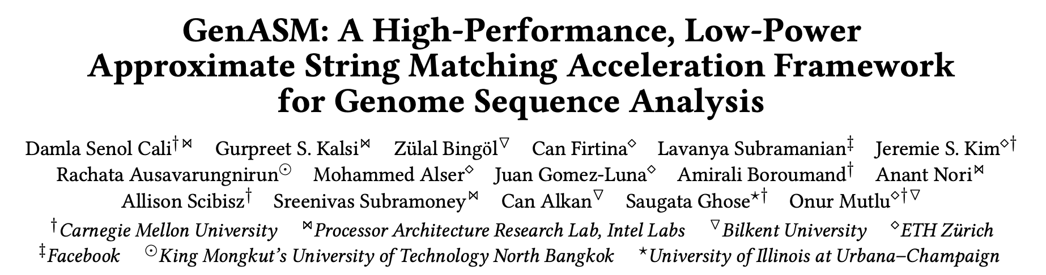
GenASM [MICRO 2020]
Damla Senol Cali, Gurpreet S. Kalsi, Zulal Bingol, Can Firtina, Lavanya Subramanian, Jeremie S. Kim, Rachata Ausavarungnirun, Mohammed Alser, Juan Gomez-Luna, Amirali Boroumand, Anant Nori, Allison Scibisz, Sreenivas Subramoney, Can Alkan, Saugata Ghose, and Onur Mutlu,
"GenASM: A High-Performance, Low-Power Approximate String Matching Acceleration Framework for Genome Sequence Analysis”
Proceedings of the 53rd International Symposium on Microarchitecture (MICRO), Virtual, October 2020.
Notes:
You can refer to our paper for more details.

Slide 59
Research Contributions
Bottleneck analysis of genome assembly pipeline for long reads
[Briefings in Bioinformatics, 2018]
GenASM: Approximate string matching framework for
genome sequence analysis
[MICRO 2020]
BitMAc: FPGA-based near-memory acceleration of
bitvector-based sequence alignment
[Ongoing]
SeGraM: Hardware acceleration framework for
sequence-to-graph mapping
[Ongoing]
Notes:
Next I will talk about 2 ongoing works, where we build upon GenASM.
First one, BitMAC is where we propose the FPGA-based near-memory acceleration …

Slide 60
BitMAc: FPGA-based GenASM
Our Goal:
Map GenASM accelerators to an FPGA with HBM2,
where HBM2 offers high memory bandwidth and
FPGA resources offer high parallelism by instantiating
multiple copies of the GenASM accelerators
Re-modified GenASM algorithms for a better mapping to the FPGA resources
Intra-level parallelism by instantiating multiple processing elements (PEs) for the DC execution
Inter-level parallelism by running multiple independent GenASM executions in parallel
Notes:
In this work, we propose BitMAc, where we leverage a modern FPGA with high-bandwidth memory (HBM) for presenting an FPGA-based prototype for our GenASM accelerators. Our goal is to ...
First, we re-modified ...
Second, we exploit ...
And third, we exploit ...
Changes:
However, for a better mapping, here in our BitMAc design, to match the width of the data port of M20Ks (40 bits) and to decrease the amount of data written to M20Ks, we set the window size as 60 and we store only 2 out of the 4 intermediate bitvectors (i.e., deletion and match) since substitution bitvector can be obtained using the deletion bitvector and if none of these 3 bitvectors contain the 0-of-interest at the position-of-interest, it means that insertion bitvector has it, thus it is not required to explicitly store the fourth bitvector. These changes enable us to decrease the amount of data generated by each processing element of the DC accelerator to be 120 bits (instead of the original 192 bits), which is 3 times of the width of an M20K data bus.
Since we have 6847 many M20Ks in our FPGA and since we need 3 M20K ports for each processing element, within our budget, we can instantiate 2282 many processing elements (PEs). To be able to instantiate multiple BitMAc accelerators to exploit inter-level parallelism, we set the number of PEs as 16, based on our empirical analysis. This enables us to set the error threshold (k) for each window of the BitMAc execution as 15 since for each error value (0...k), we have one dedicated PE (Figure 4-4). With this configuration, we can instantiate maximum of 142 BitMAc accelerators on our FPGA.
In order to exploit the high-bandwidth that the HBM2 stacks provide, we store our inputs (text-pattern pairs) and output (CIGAR string) in the HBM2 memory. Since we have 32 pseudo-channels in total, we can attach 4 BitMAc accelerators to each of these pseudo-channels not to exceed our 142 accelerator limit

Slide 61
Key Findings
Based on the FPGA resources, the complete BitMAc design:
4 BitMAc accelerators connected to each pseudo-channel (128 in total)
Each BitMAc accelerator contains a DC accelerator with 16 PEs, a TB accelerator, an FSM, and 13.2KB of M20Ks
Clocked at 200MHz
BitMAc provides:
136× – 761× speedup over the state-of-the-art CPU baselines
6.8× – 19.4× speedup over the state-of-the-art GPU baseline
Notes:
The complete BitMAc design has 4 BitMAc accelerators connected to each pseudo-channel
(128 in total), [CLICK] where each BitMAc accelerator contains a DC accelerator with 16 PEs, a TB accelerator, an FSM, and 13.2KB of M20Ks. We synthesize and place & route the complete BitMAc design clocked at 200 MHz, and report the resource utilization and power analysis results based on the compilation flow that Intel Quartus Prime
provides. We also modify the spreadsheet-based analytical model of GenASM based on our new BitMAc design, and report our performance results based on this analytical model.
We perform our BitMAc evaluation for the read alignment use case (See Section 4.8). Similar to GenASM, we compare BitMAc with (1) the read alignment steps of Minimap2 [136] and BWA-MEM [134] as the CPU-based baselines, and (2) GASAL2 [6] as the GPU-based baseline.
[CLICK]

Slide 62
Key Findings (cont’d.)
BitMAc has:
64% logic utilization and 90% on-chip memory utilization
Total power consumption of 48.9W, where 59% accounts for the M20Ks
Bottlenecked by the amount of on-chip memory (i.e., M20Ks)
Cannot saturate the high bandwidth that multiple HBM2 stacks on the FPGA provide
Need (1) algorithm-level modifications to decrease the amount of data that need to be stored in M20Ks, and (2) newer FPGA chips that provide a higher amount of on-chip memory capacity
Notes:
[CLICK]
[CLICK]
When we look at the power dissipation analysis by block type for our complete BitMAc design, we find that 59% of the total dissipation accounts for the M20Ks, 9%
accounts for the combination cells, 7% accounts for the register cells, 13% accounts for the clock network, and 12% accounts for the static power dissipation. Thus, M20Ks are the main contributors to the total on-chip power dissipation.
Even though we find that there is a linear scaling of the FPGA resources with the number of instances we include in our design.
Due to high amount of data that needs to be stored for the TB execution on M20Ks, we are bottlenecked by the amount of on-chip memory (i.e., M20Ks) we have.
We show that the total power dissipation of a single BitMAc accelerator is 6 W. We also show that for 32 BitMAc accelerators (one BitMAc accelerator per pseudo-channel), the total power dissipation is 17.2W, and for 128 BitMAc accelerators (four BitMAc accelerators per pseudo-channel; our complete design), the total power dissipation is 48.9 W.

Slide 63
Research Contributions
Bottleneck analysis of genome assembly pipeline for long reads
[Briefings in Bioinformatics, 2018]
GenASM: Approximate string matching framework for
genome sequence analysis
[MICRO 2020]
BitMAc: FPGA-based near-memory acceleration of
bitvector-based sequence alignment
[Ongoing]
SeGraM: Hardware acceleration framework for
sequence-to-graph mapping
[Ongoing]
Notes:
In our fourth work, we explore how we can utilize this BW by also including another step of read mapping pipeline to our design. But also, here in this work, we explore a similar but different genomics problem: sequence-to-graph mapping.

Slide 64
Recall: Read Mapping Pipeline
Reference genome
Indexing
(Pre-processing step to generate index of reference)
reference bias
Hash-table based index
Reads
Seeding
(Query the index)
Potential mapping
locations
Reference
segment
Pre-Alignment Filtering
(Filter out dissimilar sequences)
Query read
Remaining potential mapping locations
Read Alignment
(Perform distance/score calculation & traceback)
Optimal alignment
Notes:
As you recall, in read mapping, we start with a linear sequence of a single reference genome. However, this linear representation of the reference genome results with ignoring the variations that exist in a population (i.e., genetic diversity) and introducing biases for the downstream analysis. To address these limitations, recently, graph-based representations of the genomes (i.e., genome graphs) have gained attention.

Slide 65
Genome Graphs
Genome graphs:
Include the reference genome together with genetic variations
Provide a compact representation
Enable us to move away from aligning with single reference genome (reference bias) and toward using the sequence diversity
Reference #1: ACGTACGT
ACGTACGT
Notes:
Genome graphs include …

Slide 66
Genome Graphs
Genome graphs:
Include the reference genome together with genetic variations
Provide a compact representation
Enable us to move away from aligning with single reference genome (reference bias) and toward using the sequence diversity
Reference #1: ACGTACGT
Reference #2: ACGGACGT
ACGTACGT

Slide 67
Genome Graphs
Genome graphs:
Include the reference genome together with genetic variations
Provide a compact representation
Enable us to move away from aligning with single reference genome (reference bias) and toward using the sequence diversity
T
Reference #1: ACGTACGT
Reference #2: ACGGACGT
ACG
ACGT
G

Slide 68
Genome Graphs
Genome graphs:
Include the reference genome together with genetic variations
Provide a compact representation
Enable us to move away from aligning with single reference genome (reference bias) and toward using the sequence diversity
T
Reference #1: ACGTACGT
Reference #2: ACGGACGT
Reference #3: ACGTTACGT
ACG
ACGT
G

Slide 69
Genome Graphs
Genome graphs:
Include the reference genome together with genetic variations
Provide a compact representation
Enable us to move away from aligning with single reference genome (reference bias) and toward using the sequence diversity
T
Reference #1: ACGTACGT
Reference #2: ACGGACGT
Reference #3: ACGTTACGT
ACG
ACGT
T
G

Slide 70
Genome Graphs
Genome graphs:
Include the reference genome together with genetic variations
Provide a compact representation
Enable us to move away from aligning with single reference genome (reference bias) and toward using the sequence diversity
T
Reference #1: ACGTACGT
Reference #2: ACGGACGT
Reference #3: ACGTTACGT
Reference #4: ACGACGT
ACG
ACGT
T
G

Slide 71
Genome Graphs
Genome graphs:
Include the reference genome together with genetic variations
Provide a compact representation
Enable us to move away from aligning with single reference genome (reference bias) and toward using the sequence diversity
T
Reference #1: ACGTACGT
Reference #2: ACGGACGT
Reference #3: ACGTTACGT
Reference #4: ACGACGT
ACG
ACGT
T
G

Slide 72
Problem & Motivation
Traditional read mapping causes reference bias
Aligning sequences to graphs is a newer field and only a few software tools exist for graph-based GSA
Graph-based analysis exacerbates mapping’s bottlenecks
Hardware acceleration of sequence-to-graph mapping: important but unexplored research problem
Notes:
So, [CLICK] since traditional read mapping causes reference bias,
[CLICK] aligning sequences to graphs emerges a newer field and practical tools only start to emerge, where most of the existing tools are specialized for one purpose.
[CLICK] Given the additional complexities and overheads of processing a genome graph instead of a linear reference genome, graph-based analysis exacerbates analysis bottlenecks such as read-to-reference mapping.
[CLICK} Thus, HW acceleration of sequence-to-graph mapping is an important but unexplored research problem.

Slide 73
SeGraM: First Graph Mapping Accelerator
Our Goal:
Design high-performance, scalable, power- and area-efficient hardware accelerators that alleviate bottlenecks in both
the seeding and alignment steps of sequence-to-graph mapping with support for both short and long reads
SeGraM:
MinSeed: The first minimizer-based seeding hardware
BitAlign: The first sequence-to-graph alignment hardware based on modified GenASM algorithms and accelerators
Notes:
[CLICK] Thus, in SeGraM, our goal is to design …
[CLICK] To this end, [CLICK] we propose SeGraM, the first hardware acceleration framework for sequence-to-graph mapping and alignment.
SeGraM consists of two main components:
[CLICK] MinSeed, …
[CLICK] BitAlign, …

Slide 74
Overview of SeGraM
Main Memory (graph-based reference & index)
frequencies
seed locations
graph nodes
3
5
7
SeGraM
MinSeed (MS)
BitAlign (BA)
Minimizer Scratchpad
Seed Scratchpad
DC-SRAM
(Input Scratchpad)
8
Generate Bitvectors
Hop Queues
9
minimizers
2
4
6
10
Find Minimizers
Filter
Frequencies
Calculate
Seed Regions
TB-SRAMs
(Bitvector Scratchpad)
query k-mers
Host CPU
11
1
Read
Scratchpad
Perform
Traceback
query
read
Notes:
Before SeGraM execution starts, as the pre-processing steps, each chromosome’s graph structure is generated, then each graph’s nodes are indexed, and both the resulting graph and hash-table index are pre-loaded to the main memory.
[CLICK] SeGraM execution starts when the query read is streamed from the host CPU and MinSeed writes it to the read scratchpad ( 1 ).
[CLICK] Using all of the k-mers of the query read, MinSeed finds the minimizers and writes them to the minimizer scratchpad ( 2 ).
[CLICK] For each minimizer, MinSeed fetches its frequency from the hash table at the main memory ( 3 ) and [CLICK] filters out the minimizers whose frequency is above an user-defined threshold ( 4 ). [CLICK] Next, MinSeed fetches the seed locations of the remaining minimizers from the main memory, and writes them to the seed scratchpad ( 5 ).
[CLICK] Finally, MinSeed calculates the candidate reference region for each seed ( 6 ),
[CLICK] fetches the graph nodes from the memory for each candidate region and writes them to the input scratchpad ( 7 ).
Once MinSeed sends the subgraph corresponding to the candidate reference region along with the query read, [CLICK] BitAlign execution starts with generating the bitvectors ( 8 ) required for the distance calculation step of the alignment (i.e., seed-extension).
[CLICK] While generating these bitvectors, BitAlign writes them to the hop queues in order to handle the hops required for the graph alignment ( 9 ),
[CLICK] and also, to the bitvector scratchpad ( 10 ).
Once BitAlign finishes generating and writing all the bitvectors, [CLICK] it starts reading them back from the bitvector scratchpad, performs the traceback operation, and finds the optimal alignment between the subgraph and the query read
(11).

Slide 75
MinSeed HW
Three computation modules responsible for finding the minimizers, filtering the frequencies of minimizers, and finding the associated regions of every seed location
Three scratchpads for storing the query read, its minimizers, and seed locations
The memory interface, which handles the frequency, seed location, and subgraph accesses
Notes:
Let’s look at the HW design of MinSeed.

Slide 76
BitAlign HW
Linear cyclic systolic array-based accelerator
Hop queue registers to incorporate the hops by feeding the bitvectors of non-neighbor characters/nodes
Notes:
Let’s look at the HW design of BitAlign.

Slide 77
Overall System of SeGraM
A single SeGraM consists of 8 MinSeed modules that exploit data-level parallelism when performing seeding
Each MinSeed module has exclusive access to one HBM2E channel
Each MinSeed module is connected to a single BitAlign module
We hide the latency of MinSeed when performing seeding while running sequence-to-graph alignment with BitAlign
Notes:
We replicate the content of each HBM2E stack (i.e., graph-based reference and hash table based index) among the 4 independent stacks.
Within each stack, we distribute the graph and index structures of the 24 chromosomes based on their sizes among the 8 independent channels.

Slide 78
Use Cases of SeGraM
End-to-End Sequence-to-Graph Mapping
The whole SeGraM design (MinSeed + BitAlign) should be executed
We support both short and long reads
Sequence-to-Graph Alignment
BitAlign can be executed by itself without the need of an initial seeding tool/accelerator
BitAlign can also be used for sequence-to-sequence alignment since it is a special and simpler variant of sequence-to-graph alignment
Seeding
MinSeed only can be used as the seeding module for both graph-based mapping and linear traditional mapping
MinSeed is orthogonal to be coupled with any alignment tool or accelerator
Notes:
BitAlign can be executed by itself without the need of an initial seeding tool/accelerator
BitAlign can also be used for sequence-to-sequence alignment since it is a special and simpler variant of sequence-to-graph alignment

Slide 79
Evaluation Methodology
We evaluate SeGraM using:
Synthesized SystemVerilog models of the MinSeed and BitAlign accelerator datapaths
Simulation- and spreadsheet-based performance modeling
4 x 24GB HBM2E stacks, each with 8 independent channels
1 MinSeed and 1 BitAlign HW per each channel (32 in total)
Baseline tools:
GraphAligner and vg for sequence-to-graph mapping
PaSGAL for sequence-to-graph alignment
Darwin, GenAx, and GenASM for sequence-to-sequence alignment
Simulated datasets for both short and long reads
Notes:
We evaluate ...
We model the memory component as a 4 stacks of HBM2, each with ...
For each channel, we have ...
We compare SeGraM with [CLICK] ... and using [CLICK] simulated reads ...
We evaluate SeGraM using the latest major release of the human genome assembly, GRCh38 [2], as the starting reference genome. For the variations, we use 7 VCF files for HG001-007 from the GIAB project (v3.3.2) [105].

Slide 80
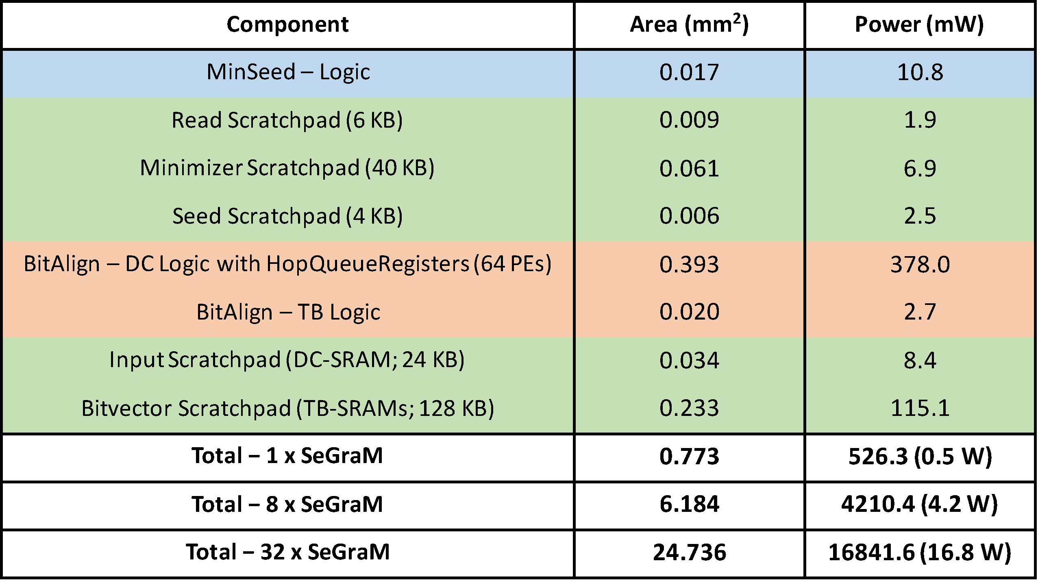
Key Results – Area & Power
Based on our synthesis of MinSeed and BitAlign accelerator datapaths using the Synopsys Design Compiler with a 28nm process (@ 1GHz):
Notes:
Based on …
We find that the total area overhead of SeGraM attached to all 32 channels is around 25mm2 and the total power consumption is around 17 W.
We find that the main contributors for the area overhead and power consumption are (1) hopQueueRegisters since they constitute more than 60% of the area and power of BitAlign-DC logic, and (2) the bitvector scratchpads (TB- SRAMs).
Here we show the area and power breakdown of the compute (i.e., logic) units and the memory components (i.e., scratchpads) in SeGraM, and the total area overhead and power consumption of (1) a single SeGraM accelerator (attached to a single channel), (2) 8 SeGraM accelerators (in a single stack with 8 channels), and (3) 32 SeGraM accelerators (in 4 stacks).

Slide 81
Key Results – SeGraM with Long Reads (I)
SeGraM provides 8.8× throughput improvement over GraphAligner’s 12-thread execution,
while reducing the power consumption by 4.9×
Notes:
When we look at our long read analysis, we find that [CLICK][CLICK]

Slide 82
Key Results – SeGraM with Long Reads (II)
SeGraM provides 7.3× throughput improvement over vg’s 12-thread execution,
while reducing the power consumption by 6.5×

Slide 83
Key Results – SeGraM with Short Reads (I)
SeGraM provides 168× throughput improvement over GraphAligner’s 12-thread execution,
while reducing the power consumption by 4.7×
Notes:
and when we look at our short read analysis, we find that [CLICK][CLICK]

Slide 84
Key Results – SeGraM with Short Reads (II)
SeGraM provides 726× throughput improvement over vg’s 12-thread execution,
while reducing the power consumption by 4.9×

Slide 85
Key Results – BitAlign (Graph Alignment)
BitAlign provides 41×-539× speedup over
the 48-thread AVX512-supported
execution of PaSGAL
Notes:
Let’s look at the key results for the sequence-to-graph alignment module of SeGraM, which is BitAlign.

Slide 86
Key Results – BitAlign (Linear Alignment)
BitAlign can be used for both sequence-to-sequence alignment and sequence-to-graph alignment
The cost of more functionality: Extra hop queue registers in BitAlign
However, we do not sacrifice any performance
For long reads (over GACT of Darwin and GenASM):
4.8× and 1.2× throughput improvement,
1.9× and 5.2× higher power consumption, and
1.4× and 2.3× higher area overhead
For short reads (over SillaX of GenAx and GenASM):
2.4× and 1.3× throughput improvement
Notes:
GACT of Darwin is optimized for long reads, SillaX of GenAx is optimized for short reads, and GenASM is optimized for both short and long reads.
We use the optimum configuration of each accelerator reported in their corresponding papers.

Slide 87
Summary of SeGraM
Problem:
Traditional read mapping causes reference bias
Aligning sequences to graphs is a newer field and only a few software tools exist for graph-based GSA
Graph-based analysis exacerbates mapping’s bottlenecks
Hardware acceleration of sequence-to-graph mapping: important but unexplored research problem
Key Contributions:
SeGraM: First acceleration framework for sequence-to-graph mapping
MinSeed: First minimizer-based seeding accelerator
BitAlign: First sequence-to-graph alignment accelerator based upon our new bitvector-based, highly-parallel algorithm
Key Results: SeGraM and BitAlign provide significant speedups compared to the software baselines, while reducing the power consumption
Notes:
To summarize,
So, since traditional read mapping causes reference bias, aligning sequences to graphs emerges a newer field and practical tools only start to emerge, where most of the existing tools are specialized for one purpose. Given the additional complexities and overheads of processing a genome graph instead of a linear reference genome, graph-based analysis exacerbates analysis bottlenecks of read mapping. Thus, HW acceleration of sequence-to-graph mapping is an important but unexplored research problem.
Thus, in this work, we propose SeGraM, the first hardware acceleration framework for sequence-to-graph mapping. We base SeGraM on a memory-efficient minimizer-based seeding algorithm and a novel bitvector-based, highly- parallel sequence-to-graph alignment algorithm. We co-design both of our algorithms with high-performance, area- and power-efficient hardware accelerators, and propose the first HW accelerators for both.
We compare SeGraM and BitAlign with state-of-the-art sequence-to-graph mappers and aligners, and we find that both provides significant speedup compared to the the baselines, while reducing the power consumption.

Slide 88
Research Contributions
Bottleneck analysis of genome assembly pipeline for long reads
[Briefings in Bioinformatics, 2018]
GenASM: Approximate string matching framework for
genome sequence analysis
[MICRO 2020]
BitMAc: FPGA-based near-memory acceleration of
bitvector-based sequence alignment
[Ongoing]
SeGraM: Hardware acceleration framework for
sequence-to-graph mapping
[Ongoing]
Notes:
And with SeGraM, we cover all the pieces that create my PhD work.

Slide 89
Conclusion
Rapid genome sequence analysis is bottlenecked
by the computational power and memory bandwidth limitations of existing systems,
as many of the steps in genome sequence analysis must process a large amount of data
Notes:
To conclude, ...

Slide 90
Conclusion (cont’d.)
Genome sequence analysis can be accelerated
by co-designing fast and efficient algorithms
along with scalable and energy-efficient customized hardware accelerators
for the key bottleneck steps of the pipeline
Notes:
But genome sequence analysis can be accelerated by …

Slide 91
Conclusion (cont’d.)
Bottleneck analysis of genome assembly pipeline for long reads
[Briefings in Bioinformatics, 2018]
GenASM: Approximate string matching framework for
genome sequence analysis
[MICRO 2020]
BitMAc: FPGA-based near-memory acceleration of
bitvector-based sequence alignment
[Ongoing]
SeGraM: Hardware acceleration framework for
sequence-to-graph mapping
[Ongoing]
Notes:
To this end, in my first work, we aimed to understand where the current tools and algorithms do not perform well in order to develop better tools and algorithms, and to understand the limitations of existing hardware systems when running these tools and algorithms in order to design efficient customized accelerators. For this work, our key takeaway is we need memory-efficient, low-power, and scalable designs for genomics in order to exploit the advantages that new sequencing technologies provide, such as near sequencing device analysis for real-time analysis, portability to perform GS & GSA anywhere in the world (even remote places) etc.
To this end, in my second work, we propose GenASM, HW/Alg co-design to accelerate one of the key bottlenecks of GSA: ASM. In GenASM, we co-design our modified scalable and memory-efficient algorithms with low-power and area-efficient hardware accelerators. We evaluate three different use cases and we show that GenASM is significantly more efficient for all the three use cases than state-of-the-art software and hardware baselines
My third work is the FPGA mapping of our GenASM accelerators, where we implement and map GenASM-DC and GenASM-TB to an FPGA with HBM2 and provide an FPGA-based prototype, BiMAc.
And, in my final work, instead of traditional read mapping, we focus on graph mapping problem, which is a newer genomics problem, to get rid of the reference bias and provide a more comprehensive and accurate solution for the one of the key GSA steps, read mapping. To this end, we propose SeGraM, the first hardware acceleration framework for sequence- to-graph mapping, that targets both seeding and alignment steps of sequence-to-graph mapping, which supports both short and long reads.

Slide 92
Future Work
Incorporating a Filtering Approach for SeGraM
GenASM-based Algorithm for Sequence Alignment with the Affine Gap Model
End-to-End Acceleration of the Mapping Pipeline
Accelerating Assembly with Long Reads

Slide 93
Accelerating Genome Sequence Analysis via Efficient Hardware/Algorithm Co-Design
Damla Senol Cali
Staff Software Engineer, Hardware Acceleration
Bionano Genomics
Email: damlasenolcali@gmail.com
Website: https://damlasenolcali.github.io
SAFARI Live Seminar
November 7, 2021
Notes:
Hello, I am Damla Senol Cali. Thank you so much for joining to my talk!
I am a Staff Software Engineer, Hardware Acceleration at Bionano Genomics. I received my Ph.D. degree in Computer Engineering from the SAFARI Research Group at Carnegie Mellon University in August this year, where I was advised by Prof. Onur Mutlu and Prof. Saugata Ghose.
And today, I'll be discussing some of the work I have been doing during my PhD on ”Accelerating Genome Sequence Analysis via Efficient Hardware/Algorithm Co-Design".

Slide 94
Other Publications @ SAFARI
FPGA-based Near-Memory Acceleration of Modern Data-Intensive Applications (IEEE Micro, 2021)
Gagandeep Singh, Mohammed Alser, Damla Senol Cali, Dionysios Diamantopoulos, Juan Gomez-Luna, Henk Corporaal, and Onur Mutlu.
Accelerating Genome Analysis: A Primer on an Ongoing Journey (IEEE Micro, 2020)
Mohammed Alser, Zulal Bingol, Damla Senol Cali, Jeremie S. Kim, Saugata Ghose, Can Alkan, and Onur Mutlu.
Apollo: A Sequencing-Technology-Independent, Scalable, and Accurate Assembly Polishing Algorithm (Bioinformatics, 2020)
Can Firtina, Jeremie S. Kim, Mohammed Alser, Damla Senol Cali, A. Ercument Cicek, Can Alkan, and Onur Mutlu.
Demystifying Workload–DRAM Interactions: An Experimental Study (ACM SIGMETRICS, 2019)
Saugata Ghose, Tianshi Li, Nastaran Hajinazar, Damla Senol Cali, and Onur Mutlu.
GRIM-Filter: Fast Seed Location Filtering in DNA Read Mapping Using Processing-in-Memory Technologies (BMC Genomics, 2018)
Jeremie S. Kim, Damla Senol Cali, Hongyi Xin, Donghyuk Lee, Saugata Ghose, Mohammed Alser, Hasan Hassan, Oguz Ergin, Can Alkan, and Onur Mutlu.
Notes:
Besides these four works, I have also co-authored 5 other papers from SAFARI.

Slide 95
Backup Slides (Sequencing)

Slide 96
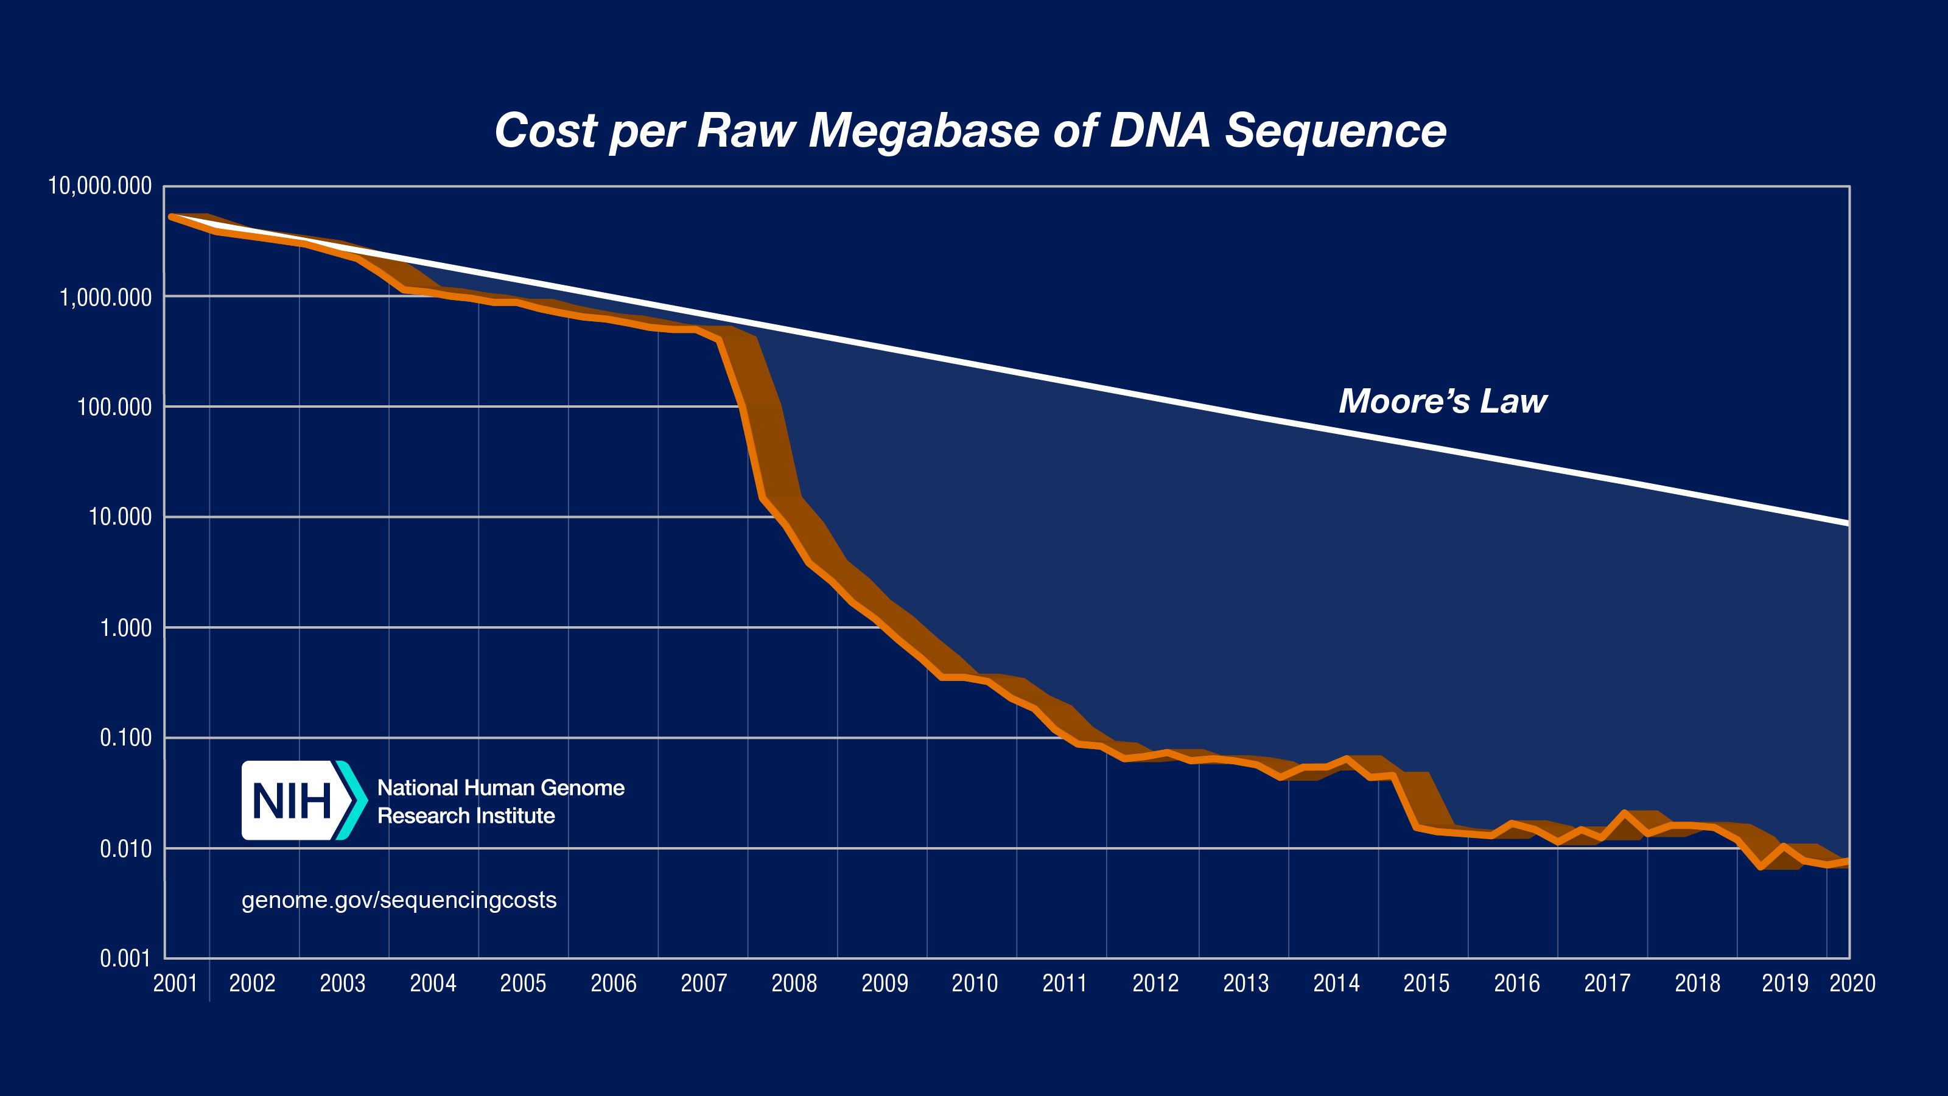
Cost of Sequencing
*From NIH (https://www.genome.gov/about-genomics/fact-sheets/DNA-Sequencing-Costs-Data)

Slide 97
Cost of Sequencing (cont’d.)
*From NIH (https://www.genome.gov/about-genomics/fact-sheets/DNA-Sequencing-Costs-Data)

Slide 98
Sequencing of SARS-CoV-2
Why genome sequencing and sequence data analysis are important?
To detect the virus from a human sample
To understand the sources and modes of transmission of the virus
To sequence the genome of the virus itself, COVID-19, in order to track the mutations in the virus
To explore the genes of infected patients
To understand why some people get more severe symptoms than others
To help with the development of new treatments
Notes:
Why genome sequencing is important?
Let's look at an example from last year and this year, which is very relevant to what whole world is experiencing right now.

Slide 99
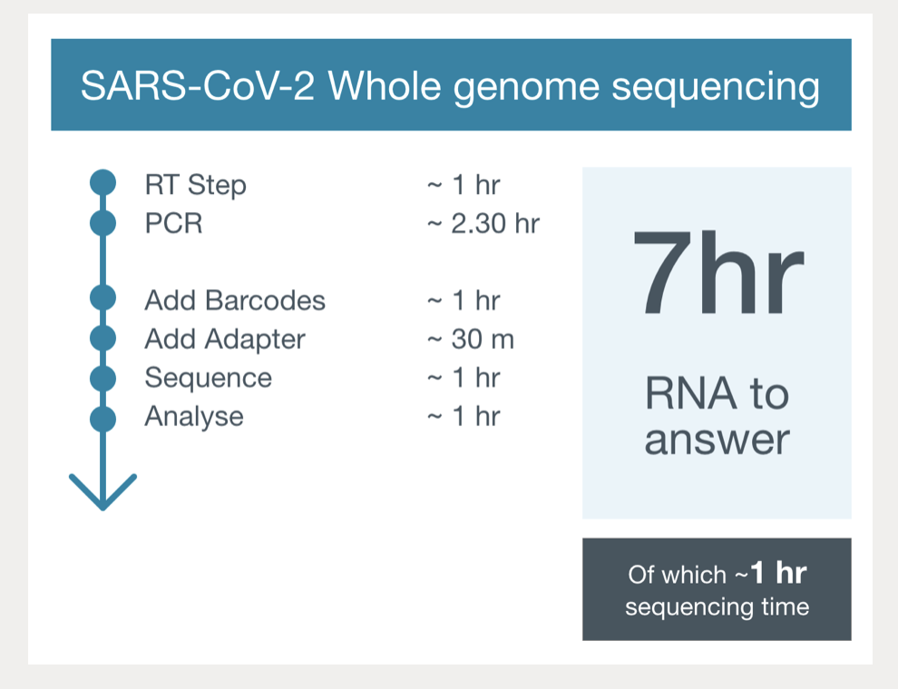
COVID-19 Research with ONT
From ONT (https://nanoporetech.com/covid-19/overview)

Slide 100
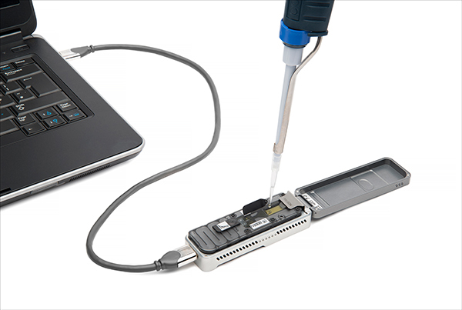
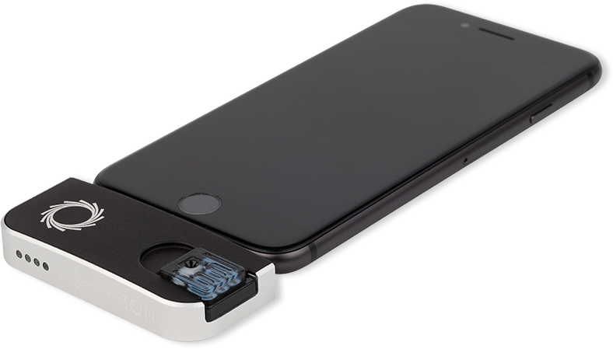
Future of Genome Sequencing & Analysis
MinION from ONT
SmidgION from ONT
Notes:
And what should we expect in near future?
Introduction of very small, portable and cheap devices that can be plugged to your mobile phones, which would enable everyone to perform sequencing on their own genome by themselves using their mobile phones.
But challenge is, how to perform the required analysis on our phones which have even more limited resources.

Slide 101
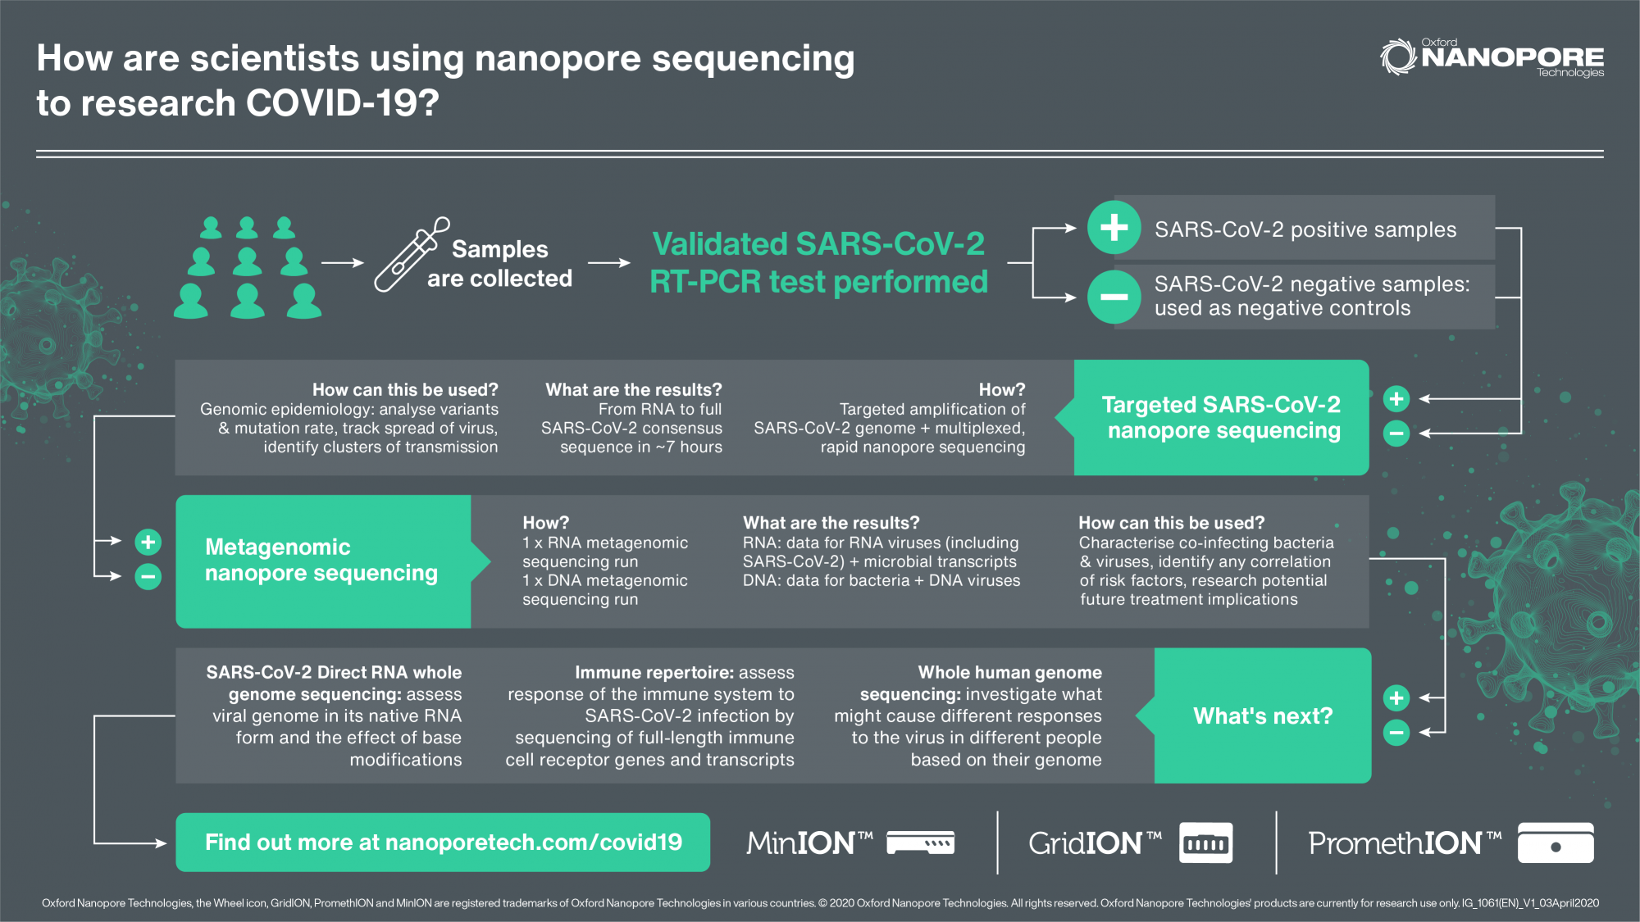
COVID-19 Research with ONT (cont’d.)
From ONT (https://nanoporetech.com/covid-19/overview)

Slide 102
Backup Slides (Nanopore)

Slide 103
Nanopore Sequencing Technology
Nanopore sequencing is an emerging and a promising single-molecule DNA sequencing technology.
First nanopore sequencing device, MinION, made commercially available by Oxford Nanopore Technologies (ONT) in May 2014.
Inexpensive
Long read length (>882Kbp)
Produces data in real time
Pocket-sized and portable
Notes:
These properties enable new potential applications of genome sequencing, such as rapid surveillance of Ebola, Zika or other epidemics where resources are limited, near-patient testing, and other applications that require real-time data analysis.

Slide 104
Nanopore Sequencing
Nanopore is a nano-scale hole.
In nanopore sequencers, an ionic current passes through the nanopores.
When the DNA strand passes through the nanopore, the sequencer measures the change in current.
This change is used to identify the bases in the strand with the help of different electrochemical structures of the different bases.
Notes:
Rely on the electronic or chemical structure of the different nucleotides for identification,

Slide 105
Step 1: Basecalling
Raw signal data
Translates the raw signal output into bases to generate DNA reads.
Basecalling
ACTGTCGAGTCGTAGAGA…TTT
DNA reads
Read-to-Read Overlap Finding
TTTGTCGAGTCGTAGAGA…TAG
Overlaps
Assembly
TAGTATATATTTTGGGGT…TAA
Assembled genome
Notes:
The output of MinION is the raw signal data that represents the changes in current when DNA strand passes through the nanopore. Thus, we start with this raw data.
The first step, basecalling, translates this raw signal output of MinION into bases (A,C,G,T) in order to generate DNA reads.

Slide 106
Step 2: Read-to-Read Overlap Finding
Raw signal data
Read-to-read overlap
is a common sequence between two reads, and
occurs when the matched regions of these reads originate from the same part of the complete genome.
Basecalling
DNA reads
Read-to-Read Overlap Finding
ACTGTCGAGTCGT…TTT
ACTGTCGAGTCGT…TTT
Overlaps
TTTGTCGAGTCGT…ACT
Assembly
ACTTATATATTTTT…TTT
Assembled genome
ACTTATATATTTTT…TTT
Notes:
Previous genome assembly methods designed for accurate and short NGS reads are not suitable for the nanopore sequencing data because of the high error rates. Instead, overlap-layout-consensus (OLC) algorithms are used for nanopore sequencing reads since they perform better with longer error-prone reads. OLC-based assembly algorithms start with finding the read-to-read overlaps, which is the second step of our pipeline. Read-to-read overlap is a common sequence between two reads and it occurs when the matched regions of these reads originate from the same part of the complete genome.

Slide 107
Step 3: Assembly
Raw signal data
Assembly algorithms,
generate an overlap graph with the overlaps from the previous step,
traverse this graph, then
construct the assembled genome.
Basecalling
DNA reads
ACTGTCGAGTCGT…TTT
Read-to-Read Overlap Finding
ACTGTCGAGTCGT…TTT
TTTGTCGAGTCGT…TAG
TTTGTCGAGTCGT…ACT
Overlaps
ACTTATATATTTTT…TTT
TAGTATATATTTTT…TAA
Assembly
ACTGTCGAGTCGT…TTT
TTTGTCGAGTCGT…ACT
ACTTATATATTTTT…TTT
ACTTATATATTTTT…TTT
TTTGTCGAGTCGT…ACT
ACTGTCGAGTCGT…TTT
Assembled genome
Which one is correct?
Notes:
After finding the read-to-read overlaps, OLC-based assembly algorithms generate an overlap graph, where each node is a read and each edge is an overlap connecting them. Genome assembly is performed by traversing this graph, producing the layout of the reads and then constructing the draft assembly.
From this example, this step can be understood as an easy step, however, because of the high error rates of nanopore sequence data, sequencing errors and multiple possible traversing paths (possibility of multiple outgoing or incoming edges of nodes) or not attached nodes (gaps), this assembly step is a complex step.

Slide 108
Experimental Methodology
Notes:
In this work, for accuracy and performance evaluations of different tools, we use three separate systems with different specifications.
We choose the first system for obtaining the outputs of each step and preforming accuracy analysis, as it has a larger memory capacity than a usual server, and with the help of a large number of cores, the tasks can be parallelized easily to get the output data quickly.
We choose the second system, called desktop, as it represents a commonly used desktop server.
We choose the third system, called big-mem, because of its large memory capacity and high number of cores. It represent the opposite of the desktop server.

Slide 109
Experimental Methodology (cont’d.)
Accuracy Metrics
Average Identity : Percentage similarity between the assembly and the reference genome
Coverage: Ratio of the #aligned bases in the reference genome to the length of reference genome
Number of mismatches: Total number of single-base differences between the assembly and the reference genome
Number of indels: Total number of insertions and deletions between the assembly and the reference genome
Performance Metrics
Wall clock time
Peak memory usage
Parallel speedup
Using /usr/bin/time & perf
Notes:
We compare each draft assembly generated after the assembly step and each improved assembly generated after the polishing step with the reference genome.
By coverage, I mean the length of the reference genome covered by the assembled genome.
By identity, I mean the percentage of number of matches between the reference genome and assembled genome.
We analyze the performance of each tool by running the associated command-line of each tool with the /usr/bin/time and also with perf.

Slide 110
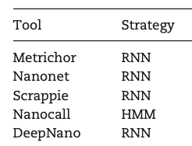
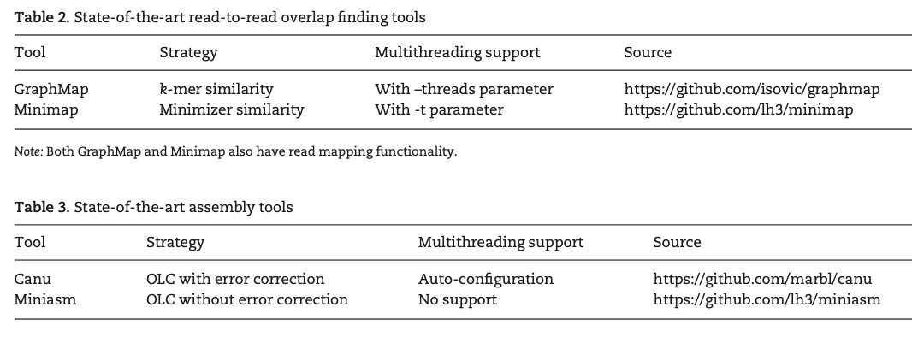
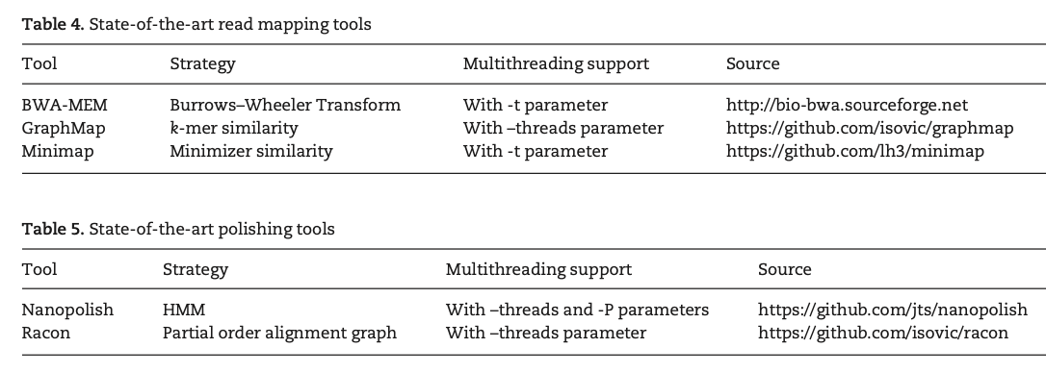
Experimental Methodology
Basecalling
Read-to-Read Overlap Finding
Assembly
Read Mapping
Polishing
Notes:
In this work, for accuracy and performance evaluations of different tools, we use three separate systems with different specifications. We use the first computer in the first part of the analysis, accuracy analysis. We use the second and third computers in the second part of the analysis, performance analysis, to compare the scalability of the analyzed tools in the two machines with different specifications. We choose the first system for evaluation, as it has a larger memory capacity than a usual server, and with the help of a large number of cores, the tasks can be parallelized easily to get the output data quickly. We choose the second system, called desktop, as it represents a commonly used desktop server. We choose the third system, called big-mem, because of its large memory capacity. This big-mem system can be useful for those who would like to get results more quickly.

Slide 111
Nanopore Basecalling Tools
Metrichor
ONT’s cloud-based basecaller
Uses recurrent neural networks (RNN) for basecalling
Nanonet
ONT’s offline and open-source alternative for Metrichor
Uses RNN for basecalling
Scrappie
ONT’s newest basecaller that explicitly addresses basecalling errors in homopolymer regions
Nanocall [David+, Bioinformatics 2016]
Uses Hidden Markov Models (HMM) for basecalling
DeepNano [Boža+, PloS One 2017]
Uses RNN for basecalling
Notes:
Nanonet: The tool supports multithreading by sharing the computation needed to call each single read between concurrent threads. In other words, only one read is called at a time.
Nanocall: It supports multithreading where each thread performs basecalling for different groups of raw reads.
DeepNano: does not have multithreading support

Slide 112
Read-to-Read Overlap Finding Tools
GraphMap [Sovic ́+, Nature Communications 2016]
First partitions the entire read data set into k-length substrings (i.e., k-mers), and then stores them in a hash table with the positions.
Detects the overlaps by finding the k-mer similarity between any two given reads, using the generated hash table.
Minimap [Li+, Bioinformatics 2016]
Partitions the entire read data set into k-mers, but instead of creating a hash table for the full set of k-mers, finds the minimum representative set of k-mers, called minimizers, and creates a hash table with only these minimizers.
Finds the overlaps between two reads by finding minimizer similarity.
Notes:
The goals of using minimizers are to (1) reduce the storage requirement of the tool by storing fewer k-mers and (2) accelerate the overlap finding process by reducing the search span.

Slide 113
GraphMap vs. Minimap
GraphMap
Finds k-mers and store them in hash table with the positions.
Finds overlaps between two reads by k-mer similarity.
Read 1:
…ACGTACGT
.
.
.
…ACGTACGT
…ACGTACGT
…ACGTACGT
…ACGTACGT
Read 2:
TACGTATA…
TACGTATA…
TACGTATA…
TACGTATA…
TACGTATA…
.
.
.
k-mers for Read 1:
k-mers for Read 2:
Notes:
For each k-mer entry, (s, i, p) triple is stored; where
s = k-mer string
i = index of the corresponding read which k-mer comes from
p = position in the read at which k-mer appears.

Slide 114
GraphMap vs. Minimap
Minimap
Finds minimum representative set of k-mers, i.e. minimizers and store them in hash table, instead of storing all k-mers.
Finds overlaps between two reads by minimizer similarity.
Read 1:
…ACGTACGT
.
.
.
…ACGTACGT
…ACGTACGT
…ACGTACGT
…ACGTACGT
Read 2:
TACGTATA…
TACGTATA…
TACGTATA…
TACGTATA…
TACGTATA…
.
.
.
minimizers for Read 1:
ACG
CGT
minimizers for Read 2:
TAC
ACG
CGT
ATA
Notes:
The aim of using minimizers is to reduce the storage space by storing fewer k-mers.
It chooses a representative k-mer from group of adjacent k-mers in such a way that different reads read-i and read-j choose the same representative if they share a long enough subsequence.
If two strings have a significant exact match, then at least one of the minimizers chosen from one will also be chosen from the other.
A set of w consecutive overlapping k-mers covers a string of exactly w+k-1 letters. To find a minimizer, w consecutive k-mers are examined and the smallest is chosen. Here, smallest means the lexicographically smallest since we are ordering letters, A,C,G and T.
→If two strings have a substring of length w+k-1 in common, then they have a (w,k)-minimizer in common.
If w=k, all letters in the read are covered except the ones in both ends. After adding them too, the whole set of minimizers are found without losing any sensitivity compared to storing all k-mers.

Slide 115
Assembly Tools
Canu [Koren+, Genome Research 2017]
Performs error-correction as the initial step of its own pipeline
Improves the accuracy of the bases in the reads
Computationally-expensive
After the error-correction step, finds overlaps between corrected reads and constructs a draft assembly
Miniasm [Li+, Bioinformatics 2016]
Skips the error-correction step, and constructs the draft assembly from the uncorrected read overlaps computed in the previous step.
Lowers computational cost but the accuracy of the draft assembly depends directly on the accuracy of the uncorrected basecalled reads.
Notes:
Canu: It finds the overlaps of the raw uncorrected reads and uses them for the error-correction. The purpose of error-correction is to improve the accuracy of the bases in the reads. However, error-correction is a computationally expensive step. In its own pipeline, Canu implements its own read-to-read overlap finding tool such that the users do not need to perform that step explicitly before running Canu. Most of the steps in the Canu pipeline are multi-threaded.
Miniasm: Although Miniasm lowers computational cost and thus accelerates and simplifies assembly by doing so, the accuracy of the draft assembly depends directly on the accuracy of the uncorrected basecalled reads. Thus, further polishing may be necessary for these draft assemblies. Miniasm does not support multithreading.

Slide 116
Read Mapping & Polishing Tools
Read Mapping tools
BWA-MEM [Li, arXiv 2013]
Commonly used long-read mapper
GraphMap and Minimap (from Step 2)
Polishing tools
Nanopolish [Loman+, Nature Methods 2015]
HMM-based approach for polishing
Racon [Vaser+, Genome Research 2017]
Alignment graph-based approach for polishing
Notes:
We do not discuss these tools in great detail here since they perform read mapping, which is commonly analyzed and relatively well understood.
Minimap2 [87] is a recently-released successor to Minimap. We compare Minimap2 to BWA-MEM and to Minimap, and make two observations. First, Minimap2 significantly outperforms BWA-MEM. Since Minimap2 can produce SAM alignments (which BWA-MEM produces), we can replace BWA-MEM with Minimap2 in future genome assembly pipelines. Second, Minimap2 has similar accuracy and performance compared to Minimap. This is because Minimap2 and Minimap employ similar indexing and seeding algorithms [87], and the new features of Minimap2 (more accurate chaining, base-level alignment, support for spliced alignment) are not used in the pipeline we analyze. As a result, our findings for Minimap generally remain the same for Minimap2.
Nanopolish: Nanopolish uses the raw signal data of reads along with the mappings from the previous step to improve the assembly base quality by evaluating and maximizing the probabilities for each base with a HMM-based approach. Although this approach can increase the accuracy significantly, it is computationally expensive, and thus time-consuming.
Racon: After dividing the sequence into segments, Racon tries to find the best alignment to increase the accuracy of the draft assembly. Racon is a fast polishing tool, but it does not promise a high increase in accuracy as Nanopolish promises.

Slide 117
Nanopore Genome Assembly Pipeline
Raw signal data
Basecalling
Tools: Metrichor, Nanonet, Scrappie, Nanocall, DeepNano
DNA reads
Read-to-Read Overlap Finding
Tools: GraphMap, Minimap
Overlaps
Assembly
Tools: Canu, Miniasm
Assembly
Draft assembly
Read Mapping
Tools: BWA-MEM, Minimap, (GraphMap)
Mappings of reads against draft assembly
Improved assembly
Polishing
Tools: Nanopolish, Racon

Slide 118
Nanopore Genome Assembly Pipeline
Raw signal data
Basecalling
Tools: Metrichor, Nanonet, Scrappie, Nanocall, DeepNano
DNA reads
Pipeline A: [Basecalling tool] + Canu
Pipeline B: [Basecalling tool] + GraphMap + Miniasm
Pipeline C: [Basecalling tool]
+ Minimap + Miniasm
Read-to-Read Overlap Finding
Tools: GraphMap, Minimap
Overlaps
Assembly
Tools: Canu, Miniasm
Assembly
Draft assembly
Read Mapping
Tools: BWA-MEM, Minimap, (GraphMap)
Mappings of reads against draft assembly
Improved assembly
Polishing
Tools: Nanopolish, Racon
Notes:
In order to compare the accuracy of the analyzed basecallers, we group the accuracy results by each basecalling tool and compare them according to the defined accuracy metrics.

Slide 119
Basecalling – Accuracy
Observation 1-a: Metrichor, Nanonet and Scrappie have similar identity and coverage trends among all of the evaluated scenarios.

Slide 120
Basecalling – Accuracy
Observation 1-b: However, Nanocall and DeepNano cannot reach these three basecallers’ accuracies: they have lower identity and lower coverage.

Slide 121
Basecalling – Accuracy
Observation 1-c: Scrappie has the highest accuracy with the lowest number of mismatches and indels.

Slide 122
Basecalling – Speed
Observation 2: RNN-based basecallers, Nanonet and Scrappie are faster than HMM-based basecaller, Nanocall.

Slide 123
Basecalling – Speed
Observation 3: When #threads=1, desktop is approximately 2x faster than big-mem because of desktop’s higher CPU frequency. It is an indication that all of these three tools are computationally expensive.
Notes:
Larger memory capacity or larger Last-Level Cache (LLC) capacity of big-mem cannot make up for the higher CPU speed in desktop when there is only one thread.

Slide 124
Basecalling – Memory
Observation 4: Scrappie and Nanocall have a linear increase in memory usage when number of threads increases. In contrast, Nanonet has a constant memory usage for all evaluated thread units.
Notes:
In Scrappie and Nanocall, each thread performs the basecalling for different groups of raw reads. Thus, each thread allocates its own memory space for the corresponding data. This causes the linear increase in memory usage when the level of parallelism increases. In Nanonet, all of the threads share the computation of each read, and thus memory usage is not affected by the amount of thread parallelism.
Scrappie: two levels of parallelism – multiple reads simultaneously (like Nanocall) but each read is processed by multiple reads in parallel (like Nanonet).

Slide 125
Basecalling – Speedup
Observation 5: When the number of threads exceeds the number of physical cores, the simultaneous multithreading overhead prevents continued linear speedup of Nanonet, Scrappie and Nanocall because of the CPU-intensive workload of these tools.
Notes:
Simultaneous multithreading (SMT) (i.e., running more than one thread per physical core [59–66]), or more specifically Intel’s hyper- threading (i.e., since we use Intel’s hyper-threading enabled machines (see Table 6)) helps to decrease the total runtime but it does not provide a linear speedup with the number of threads because of the CPU-intensive workload of Scrappie, Nanocall and Nanonet. If the threads executed are CPU-bound and do not wait for the memory or I/O requests, hyper- threading does not provide linear speedup due to the contention it causes in the shared resources for the computation.
Scrappie: two levels of parallelism – multiple reads simultaneously (like Nanocall) but each read is processed by multiple reads in parallel (like Nanonet).

Slide 126
Basecalling – Key Observations
Accuracy:
ONT’s basecallers (i.e., Metrichor, Nanonet and Scrappie) have similar identity and coverage trends among all of the evaluated scenarios. However, other two basecallers (i.e., Nanocall and DeepNano) cannot reach these three basecallers’ accuracies: they have lower identity and lower coverage
Scrappie has the highest accuracy with the lowest number of mismatches and indels
Performance:
RNN-based basecallers are faster than HMM-based basecaller
Memory Usage:
Scrappie and Nanocall have a linear increase in memory usage when number of threads increases. In contrast, Nanonet has a constant memory usage for all evaluated thread units
Scalability:
Data sharing between threads degrades the parallel speedup of Nanonet when cores from multiple NUMA nodes take role in the computation

Slide 127
Basecalling – Key Observations
Accuracy:
ONT’s basecallers (i.e., Metrichor, Nanonet and Scrappie) have similar identity and coverage trends among all of the evaluated scenarios. However, other two basecallers (i.e., Nanocall and DeepNano) cannot reach these three basecallers’ accuracies: they have lower identity and lower coverage
Scrappie has the highest accuracy with the lowest number of mismatches and indels
Performance:
RNN-based basecallers are faster than HMM-based basecaller
Memory Usage:
Scrappie and Nanocall have a linear increase in memory usage when number of threads increases. In contrast, Nanonet has a constant memory usage for all evaluated thread units
Scalability:
Data sharing between threads degrades the parallel speedup of Nanonet when cores from multiple NUMA nodes take role in the computation

Slide 128
Basecalling – Summary
The choice of the tool for the basecalling step plays an important role to overcome the high error rates of nanopore sequencing technology.
Basecalling with RNNs (e.g. Metrichor, Nanonet, Scrappie) provides higher accuracy and higher speed than basecalling with HMMs.
The newest basecaller of ONT, Scrappie, also has the potential to overcome the homopolymer basecalling problem.
Notes:
Based on the observations we make about the analyzed basecalling tools, we conclude that the choice of the tool for this step plays an important role to overcome the high error rates of nanopore sequencing technology. Basecalling with RNNs (e.g. Metrichor, Nanonet, Scrappie) provides higher accuracy and higher speed than basecalling with HMMs, and the newest basecaller of ONT, Scrappie, also has the potential to overcome the homopolymer basecalling problem.
Using RNNs is a more powerful basecalling approach than using HMMs, as an RNN 1) does not make any assumptions about sequence length and (2) is not affected by the repeats in the sequence. However, it is still challenging to determine the correct length of the homopolymers even with an RNN.

Slide 129
Nanopore Genome Assembly Pipeline
Raw signal data
Basecalling
Tools: Metrichor, Nanonet, Scrappie, Nanocall, DeepNano
DNA reads
Read-to-Read Overlap Finding
Tools: GraphMap, Minimap
Overlaps
Assembly
Tools: Canu, Miniasm
Assembly
Draft assembly
Read Mapping
Tools: BWA-MEM, Minimap, (GraphMap)
Mappings of reads against draft assembly
Improved assembly
Polishing
Tools: Nanopolish, Racon

Slide 130
Nanopore Genome Assembly Pipeline
Pipeline A: Metrichor +
[R-to-R Overlap Finding tool] + Miniasm
Pipeline B: Nanonet +
[R-to-R Overlap Finding tool] + Miniasm
Pipeline C: Scrappie +
[R-to-R Overlap Finding tool] + Miniasm
Pipeline D: Nanocall +
[R-to-R Overlap Finding tool] + Miniasm
Pipeline E: DeepNano +
[R-to-R Overlap Finding tool] + Miniasm
Raw signal data
Basecalling
Tools: Metrichor, Nanonet, Scrappie, Nanocall, DeepNano
DNA reads
Read-to-Read Overlap Finding
Tools: GraphMap, Minimap
Overlaps
Assembly
Tools: Canu, Miniasm
Assembly
Draft assembly
Read Mapping
Tools: BWA-MEM, Minimap, (GraphMap)
Mappings of reads against draft assembly
Improved assembly
Polishing
Tools: Nanopolish, Racon
Notes:
In order to compare the accuracy of these two approaches, we categorize the results in Table 10 based on read-to-read overlap finding tools. In other words, we look at the rows with the same basecaller (i.e., red-labeled tools) and same assembler (i.e., green-labeled tools) but different read-to-read overlap finder.

Slide 131
R-to-R Overlap Finding – Accuracy
Observation 5: Pipelines with GraphMap or Minimap end up with similar accuracy results.
Notes:
Pipelines with GraphMap or Minimap end up with similar values for identity, coverage, number of indels and mismatches. Thus, either of these read-to-read overlap finding tools can be used in the second step of the nanopore sequencing assembly pipeline to achieve similar accuracy.

Slide 132
R-to-R Overlap Finding – Performance
Observation 6: The memory usage of both GraphMap and Minimap is dependent on the hash table size but independent of number of threads. Minimap requires 4.6x less memory than GraphMap, on average.
Notes:
Because of the high memory usage of GraphMap, data necessary for the tool does not fit in the memory of the desktop server and we could not perform the scalability analysis of GraphMap in the desktop server.

Slide 133
R-to-R Overlap Finding – Performance
Observation 7: Minimap is 2.5x faster than GraphMap, on average. Since in Minimap, the size of dataset that needs to be scanned is greatly shrunk by storing minimizers instead of k-mers, it performs much less computation than GraphMap.
Notes:
Because of the high memory usage of GraphMap, data necessary for the tool does not fit in the memory of the desktop server and we could not perform the scalability analysis of GraphMap in the desktop server.

Slide 134
R-to-R Overlap Finding – Speedup

Slide 135
R-to-R Overlap Finding – Key Observations
Accuracy:
Pipelines with GraphMap or Minimap end up with similar accuracy results.
Memory Usage:
The memory usage of both GraphMap and Minimap is dependent on the hash table size but independent of number of threads. Minimap requires 4.6x less memory than GraphMap, on average.
Performance:
Minimap is 2.5x faster than GraphMap, on average.

Slide 136
R-to-R Overlap Finding – Summary
Storing minimizers instead of all k-mers, as done by Minimap, does not affect the overall accuracy of the first three steps of the pipeline.
By storing minimizers, Minimap has a much lower memory usage and thus much higher performance than GraphMap.

Slide 137
Nanopore Genome Assembly Pipeline
Raw signal data
Basecalling
Tools: Metrichor, Nanonet, Scrappie, Nanocall, DeepNano
DNA reads
Read-to-Read Overlap Finding
Tools: GraphMap, Minimap
Overlaps
Assembly
Tools: Canu, Miniasm
Assembly
Draft assembly
Read Mapping
Tools: BWA-MEM, Minimap, (GraphMap)
Mappings of reads against draft assembly
Improved assembly
Polishing
Tools: Nanopolish, Racon

Slide 138
Assembly – Accuracy & Performance
Observation 8: Canu provides higher accuracy than Miniasm, with the help of the error-correction step that is present in its own pipeline. On average, Canu provides 96.1% identity whereas Miniasm provides 84.4% identity.
Observation 9: Canu is much more computationally intensive and greatly (i.e., by 1096.3x) slower than Miniasm, because of its very expensive error-correction step.

Slide 139
Assembly – Summary
There is a trade-off between accuracy and performance when deciding on the appropriate tool for the assembly step.
Canu produces highly accurate assemblies, but it is resource intensive and slow. In contrast, Miniasm is a fast assembler, but it cannot produce as accurate draft assemblies as Canu.
Miniasm can potentially be used for fast initial analysis and then further polishing can be applied in the next step to produce higher-quality assemblies.

Slide 140
Nanopore Genome Assembly Pipeline
Raw signal data
Basecalling
Tools: Metrichor, Nanonet, Scrappie, Nanocall, DeepNano
DNA reads
Read-to-Read Overlap Finding
Tools: GraphMap, Minimap
Overlaps
Assembly
Tools: Canu, Miniasm
Assembly
Draft assembly
Read Mapping (optional)
Tools: BWA-MEM, Minimap, (GraphMap)
Mappings of reads against draft assembly
Improved assembly
Polishing (optional)
Tools: Nanopolish, Racon

Slide 141
Read Mapping & Polishing – Accuracy
Observation 11: Both Nanopolish and Racon significantly increase the accuracy of the draft assemblies.
For example, Nanopolish increases the identity and coverage of the draft assembly generated with the Metrichor+Minimap+Miniasm pipeline from 87.71% and 94.85%, respectively, to 92.33% and 96.31%.
Similarly, Racon increases them to 97.70% and 99.91%, respectively.
Observation 12: For Racon, the choice of read mapper does not affect the accuracy of the polishing step.

Slide 142
Read Mapping & Polishing – Speed
Observation 13: Nanopolish is computationally much more intensive and thus greatly slower than Racon.
Nanopolish runs take days to complete whereas Racon runs take minutes. This is mainly because Nanopolish works on each base individually, whereas Racon works on the windows. Since each window is much longer (i.e., 20kb) than a single base, the computational workload is greatly smaller in Racon.
Observation 14: BWA-MEM is computationally more expensive than Minimap.
Although the choice of BWA-MEM and Minimap for the read mapping step does not affect the accuracy of the polishing step, these two tools have a significant difference in performance.

Slide 143
Read Mapping & Polishing – Summary
Further polishing can significantly increase the accuracy of the assemblies.
Pipelines with Minimap and Racon can provide a significant speedup compared with the pipelines with BWA-MEM and Nanopolish, while resulting with high-quality consensus sequences.

Slide 144
Nanopore Sequencing & Tools [BiB 2018]
Damla Senol Cali, Jeremie S. Kim, Saugata Ghose, Can Alkan, and Onur Mutlu,
"Nanopore Sequencing Technology and Tools for Genome Assembly: Computational Analysis of the Current State, Bottlenecks and Future Directions."
Briefings in Bioinformatics, April 2018.

Slide 145
Backup Slides (GenASM)

Slide 146
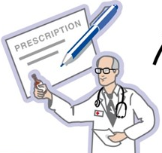
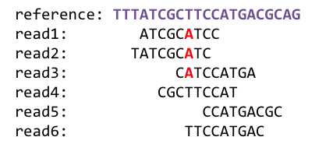
Source: Prof. Onur Mutlu’s lecture slides
1
Sequencing
Genome Analysis
Read Mapping
2
Variant Calling
Scientific Discovery
3
4
Notes:
What do we mean by genome analysis or genome sequence analysis (GSA)?
Genome analysis starts with sequencing random short DNA fragments of copies of the original molecule.
Unfortunately, these reads lack information about their order and which part of genome they are originated from.
Hence the second step is to map these reads to a long reference genome.

Slide 147
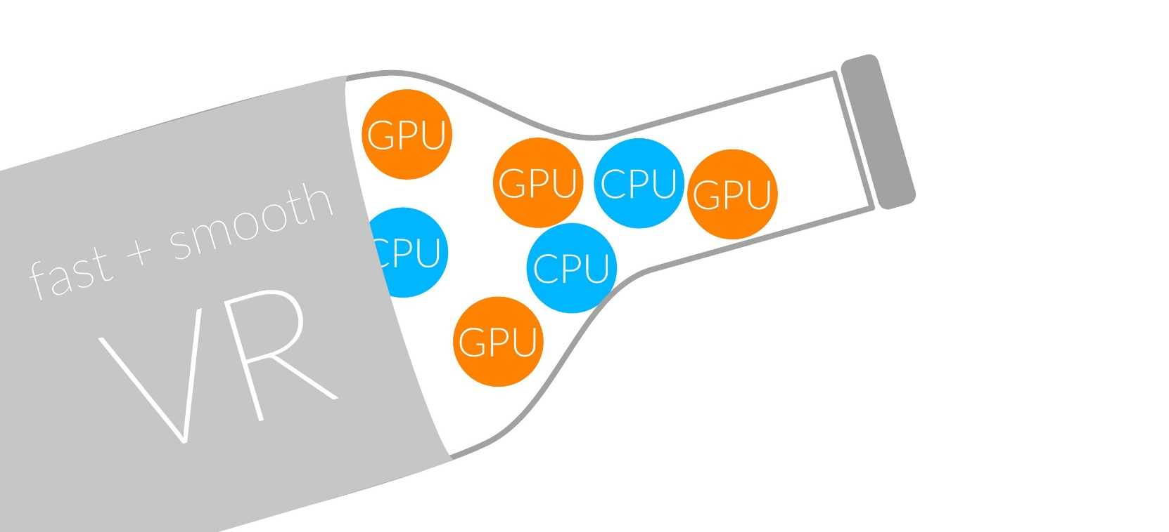
Source: Prof. Onur Mutlu’s lecture slides
1
Sequencing
Read Mapping
2
Bottlenecked in Mapping!!
Illumina HiSeq4000
on average
GAGTCAGAATTTGAC
2 M
bases/min
300 M
bases/min
GAGTCAGAATTTGAC
GAGTCAGAATTTGAC
GAGTCAGAATTTGAC
GAGTCAGAATTTGAC
GAGTCAGAATTTGAC
GAGTCAGAATTTGAC
GAGTCAGAATTTGAC
GAGTCAGAATTTGAC
GAGTCAGAATTTGAC
GAGTCAGAATTTGAC
GAGTCAGAATTTGAC
GAGTCAGAATTTGAC
GAGTCAGAATTTGAC
GAGTCAGAATTTGAC
(0.6%)
Variant Calling
Scientific Discovery
3
4
Notes:
Typical sequencer machine generates a flood of reads, for example, Illumina HiSeq4000 generates 300 million bases/minute.
However, existing computer alignment algorithms can only process 0.6% of these reads in the same amount of time.
This gap is widening as more advanced sequencers are made available in the market.

Slide 148
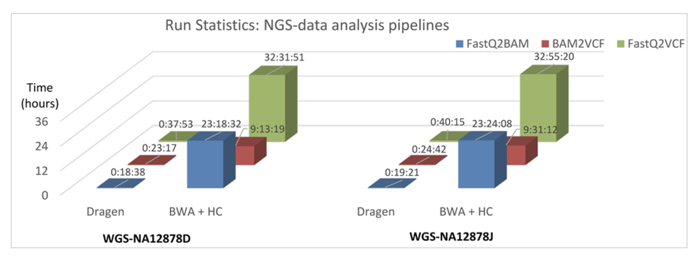
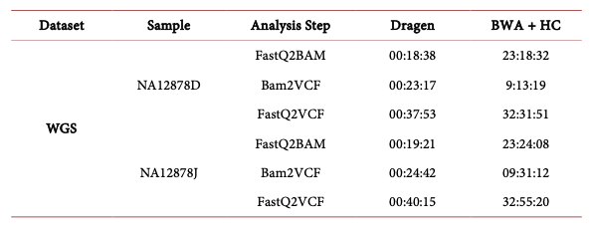
Illumina’s DRAGEN
Goyal+, "Ultra-fast next generation human genome sequencing data processing using DRAGENTM bio-IT processor for precision medicine”, Open Journal of Genetics, 2017.
Notes:
All the command utilized the multithreaded option with maximum of 48 core
DRAGEN competed alignment and BAM preprocessing for the NA12878D dataset in ~18 minute while GATK best practice pipeline took over 23 hours for the same (Figure 2). Likewise, variant calling using the GATK HaplotypeCaller completed in over 9 hours while DRAGEN Haplotype aware variant caller took just 23 minutes. All over, DRAGEN NGS data run was completed in ~37 minutes while the GATK tools over 32 hours.
For instance, high throughput NGS HiSeq X Ten System has around 18,000 humans’ whole genome sequencing capacity at 30× genome coverage annually which translates into just ~30 - 40-minute turnaround time for each genome sequencing.
fast sequencing turnaround time and roughly $1000 NGS whole genome cost is encouraging more institutes and individuals to opt for NGS based personalized medicine

Slide 149
Illumina’s DRAGEN
Goyal+, "Ultra-fast next generation human genome sequencing data processing using DRAGENTM bio-IT processor for precision medicine”, Open Journal of Genetics, 2017.
Notes:
All the command utilized the multithreaded option with maximum of 48 core
DRAGEN competed alignment and BAM preprocessing for the NA12878D dataset in ~18 minute while GATK best practice pipeline took over 23 hours for the same (Figure 2). Likewise, variant calling using the GATK HaplotypeCaller completed in over 9 hours while DRAGEN Haplotype aware variant caller took just 23 minutes. All over, DRAGEN NGS data run was completed in ~37 minutes while the GATK tools over 32 hours.
For instance, high throughput NGS HiSeq X Ten System has around 18,000 humans’ whole genome sequencing capacity at 30× genome coverage annually which translates into just ~30 - 40-minute turnaround time for each genome sequencing.
fast sequencing turnaround time and roughly $1000 NGS whole genome cost is encouraging more institutes and individuals to opt for NGS based personalized medicine

Slide 150
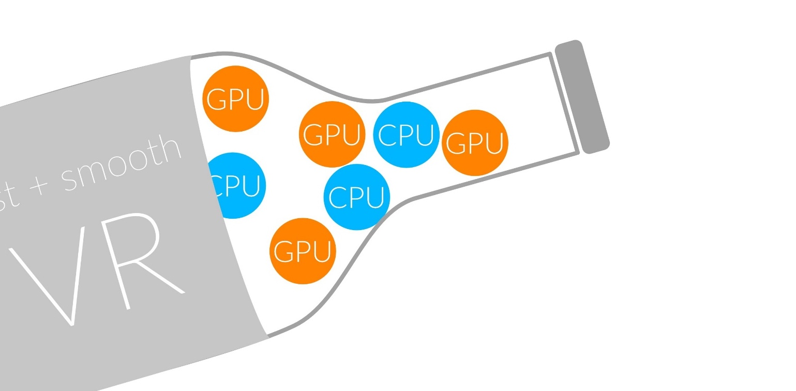
Bottlenecked in Read Mapping!!
48
1
Human whole
genomes
GAGTCAGAATTTGAC
Human
GAGTCAGAATTTGAC
genome
GAGTCAGAATTTGAC
GAGTCAGAATTTGAC
GAGTCAGAATTTGAC
GAGTCAGAATTTGAC
GAGTCAGAATTTGAC
GAGTCAGAATTTGAC
GAGTCAGAATTTGAC
at 30× coverage
GAGTCAGAATTTGAC
GAGTCAGAATTTGAC
GAGTCAGAATTTGAC
GAGTCAGAATTTGAC
32 CPU hours
GAGTCAGAATTTGAC
in about 2 days
GAGTCAGAATTTGAC
on a 48-core processor
Illumina NovaSeq 6000
Goyal+, "Ultra-fast next generation human genome sequencing data processing using DRAGENTM bio-IT processor for precision medicine”, Open Journal of Genetics, 2017.
Notes:
12.48
5.2 CPU hours
144x
60 CPU hours
BWA-MEM
25 minutes
Illumine HiSeq X10
25 minutes
Nanopore MinION
Short reads generated in a day using today’s HTS machines (e.g., Illumine HiSeq X10) can be mapped to the human reference genome using BWA-MEM [36], a popular and widely-used read mapper, in 12.5 CPU (central processing unit) days when running on a single core [66, 67]. BWA-MEM also takes about 2.5 CPU days to map long reads that are generated in 25 minutes using today’s Nanopore MinION sequencer [68]

Slide 151
What Makes Read Mapper Slow?
93%
of the read mapper’s execution time is spent in read alignment.
Alser et al, Bioinformatics (2017)
Notes:
If we analyze the execution time of current read mappers that have alignment step, we will observe that 90% of the time is spent in read alignment step.

Slide 152


What Makes Read Mapper Slow? (cont’d.)
98%
of candidate locations have high dissimilarity with a given read.
Cheng et al, BMC bioinformatics (2015)
Xin et al, BMC genomics (2013)
Notes:
We also observe that an overwhelming majority of the candidate locations have high dissimilarity with a given read, which leads to waste the time verifying these locations.
H. Cheng, et al., "BitMapper: an efficient all-mapper based on bit-vector computing," BMC bioinformatics, vol. 16, p. 1, 2015.
H. Xin, et al., "Accelerating read mapping with FastHASH," BMC genomics, vol. 14, p. S13, 2013.

Slide 153
What Makes Read Mapper Slow? (cont’d.)
Quadratic-time dynamic-programming algorithm
 |  | N | E | T | H | E | R | L | A | N | D | S
 | 0 | 1 | 2 | 3 | 4 | 5 | 6 | 7 | 8 | 9 | 10 | 11
S | 1 | 1 | 2 | 3 | 4 | 5 | 6 | 7 | 8 | 9 | 10 | 10
W | 2 | 2 | 2 | 3 | 4 | 5 | 6 | 7 | 8 | 9 | 10 | 11
I | 3 | 3 | 3 | 3 | 4 | 5 | 6 | 7 | 8 | 9 | 10 | 11
T | 4 | 4 | 4 | 3 | 4 | 5 | 6 | 7 | 8 | 9 | 10 | 11
Z | 5 | 5 | 5 | 4 | 4 | 5 | 6 | 7 | 8 | 9 | 10 | 11
E | 6 | 6 | 5 | 5 | 5 | 4 | 5 | 6 | 7 | 8 | 9 | 10
R | 7 | 7 | 6 | 6 | 6 | 5 | 4 | 5 | 6 | 7 | 8 | 9
L | 8 | 8 | 7 | 7 | 7 | 6 | 5 | 4 | 5 | 6 | 7 | 8
A | 9 | 9 | 8 | 8 | 8 | 7 | 6 | 5 | 4 | 5 | 6 | 7
N | 10 | 9 | 9 | 9 | 9 | 8 | 7 | 6 | 5 | 4 | 5 | 6
D | 11 | 10 | 10 | 10 | 10 | 9 | 8 | 7 | 6 | 5 | 4 | 5
Enumerating all possible prefixes
Data dependencies limit the computation parallelism
Processing row (or column) after another
Entire matrix is computed even though strings can be dissimilar.
Number of differences is computed only at the backtraking step.
Notes:
1- Read alignment follows the basic dynamic-programming doctrine which runs in a quadratic time.
2- Data dependencies between the entries limits the parallelism. Each cell depends or three pre-computed cells (immediate left, upper, and upper-left cells). Thus, we can compute the vectors one after another but not in parallel. Left-to-right, or top-to-bottom, anti-diagonal.
3- We can solve a significant amount of time, If we can find a way to detect the incorrect mappings with cheap heuristics, much cheaper than computing the alignment.

Slide 154
Approximate String Matching (ASM)
Approximate string matching algorithms:
Smith-Waterman (SW) algorithm [Smith+, Advances in Applied Mathematics 1981]
Dynamic programming (DP) algorithm, with quadratic time and space complexity
Common algorithm used by read mappers
Myers’ bitvector algorithm [Myers, Journal of the ACM 1999]
Transformed version of SW algorithm into bitvectors and bitwise operations
Bitap algorithm [Baeza-Yates+, Communications of the ACM 1992]
[Wu+, Communications of the ACM 1992] extended Bitap to perform approximate string matching
Bitvectors and bitwise operations
We have focused on the Bitap algorithm.
→ Reason: Bitap algorithm can perform ASM with fast and simple bitwise operations, which makes it amenable to efficient hardware acceleration.

Slide 155
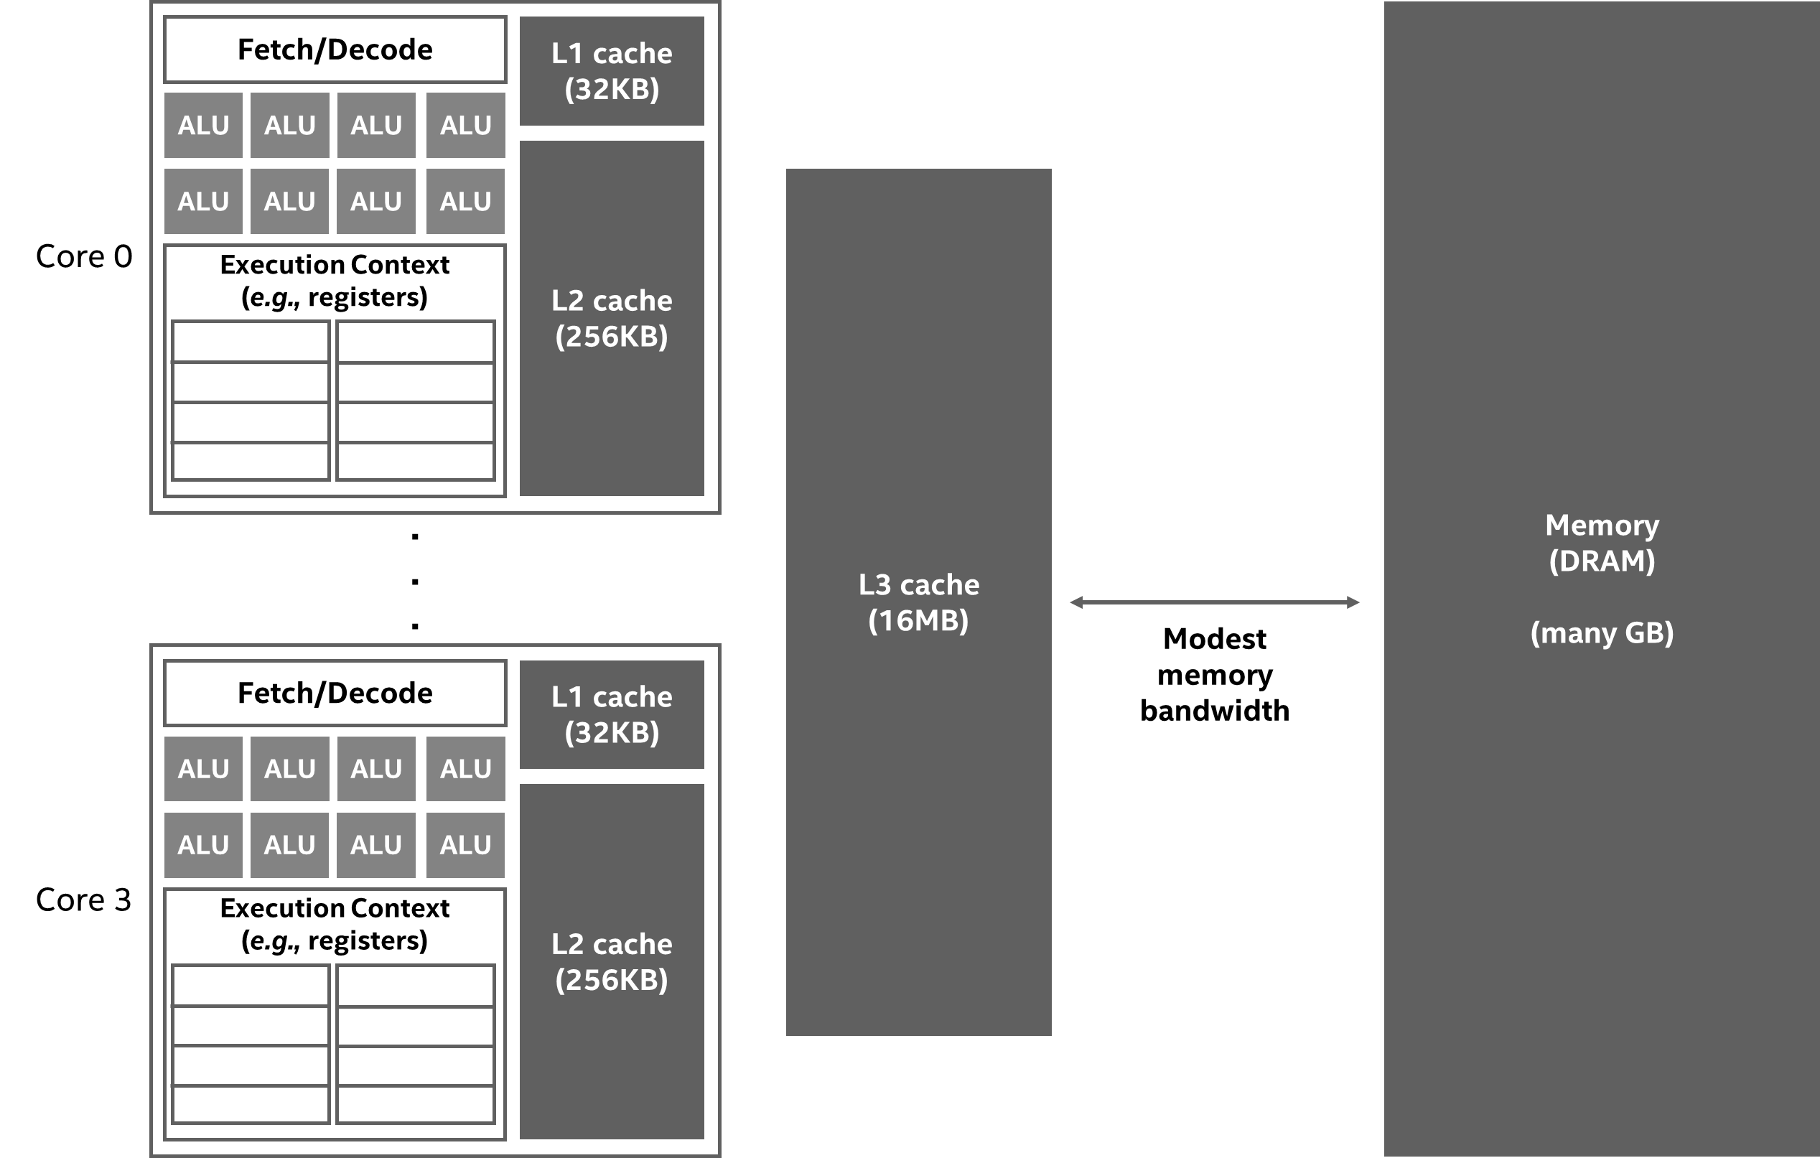
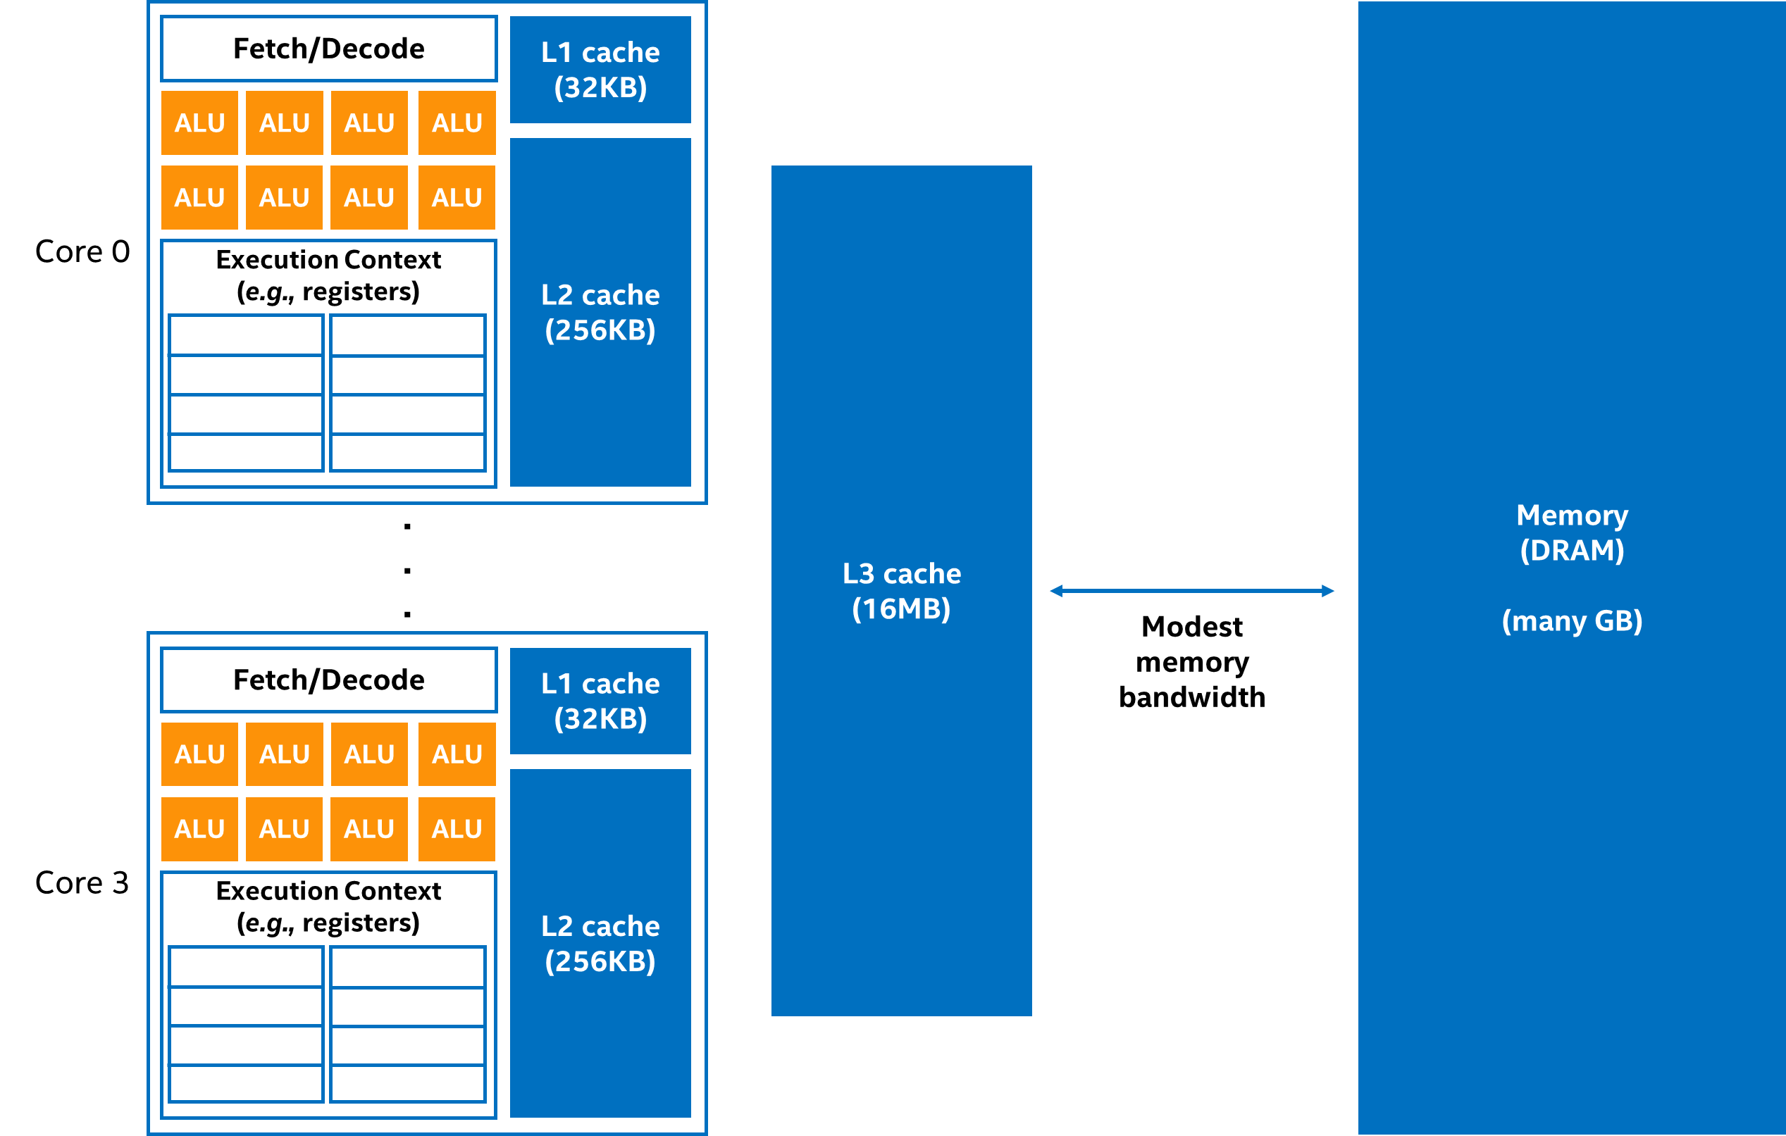
CPU Systems
Less compute, more cache
Plenty of cache per core
Low latency, low throughput processors

Slide 156
Evaluation Methodology (CPU-bitap)
Vtune analysis on a real system
System Configuration:
Intel Core i5-6600K CPU
@ 3.50GHz (Skylake)
Single socket, 4 physical cores, 1 thread per core
32KB L1 private caches, 256KB L2 private caches, 6MB shared LLC
32GB main memory
Analysis Details:
HPC performance characterization
Hardware events for MPKIs and cache hit/miss rates of each level of cache
Hotspot analysis
Gem5 + Ramulator Simulations
Gem5 Configuration:
CPU type: O3 (detailed)
Number of cores= Number of threads = 1, 2, 4, 8, 16, 32, 64
Private L1 size = 64KB each
Private L2 size = 512KB each
Shared L3 size = # cores * 1MB
Main memory type = LPDDR4 vs. HBM
Main memory size = 16GB
Analysis Details:
Execution-driven simulation
Scalability, memory-intensity (cache usage, memory bandwidth, and memory latency) and possible bottlenecks analysis
With and without L2/L3 caches

Slide 157
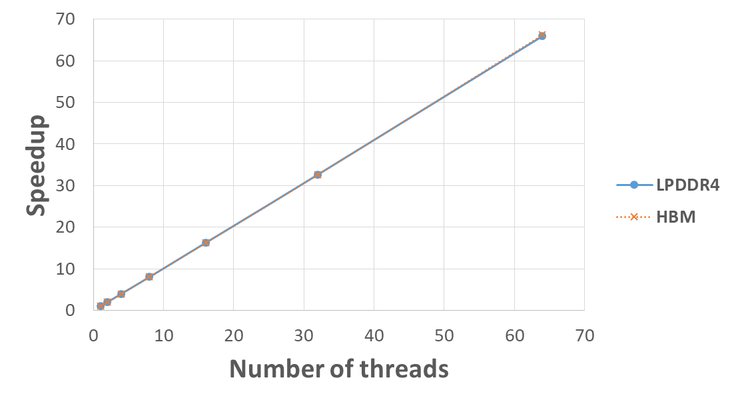
Results (CPU-bitap)

Slide 158
Results (CPU-bitap)
CPU-bitap is very compute-intensive and not memory-bound.
Lots of computation for one byte of data movement
L1-MPKI: 0.196, L2-MPKI: 0.086, LLC-MPKI: 0.037, and
Very high L1-hit rate (99.895%)
Adding more cores provides a linear speedup
Since the working set fits within the registers and the L1 cache and the number of memory requests is very low:
No performance difference without L2 and L3 caches
No performance difference between LPDDR4 or HBM as the memory

Slide 159
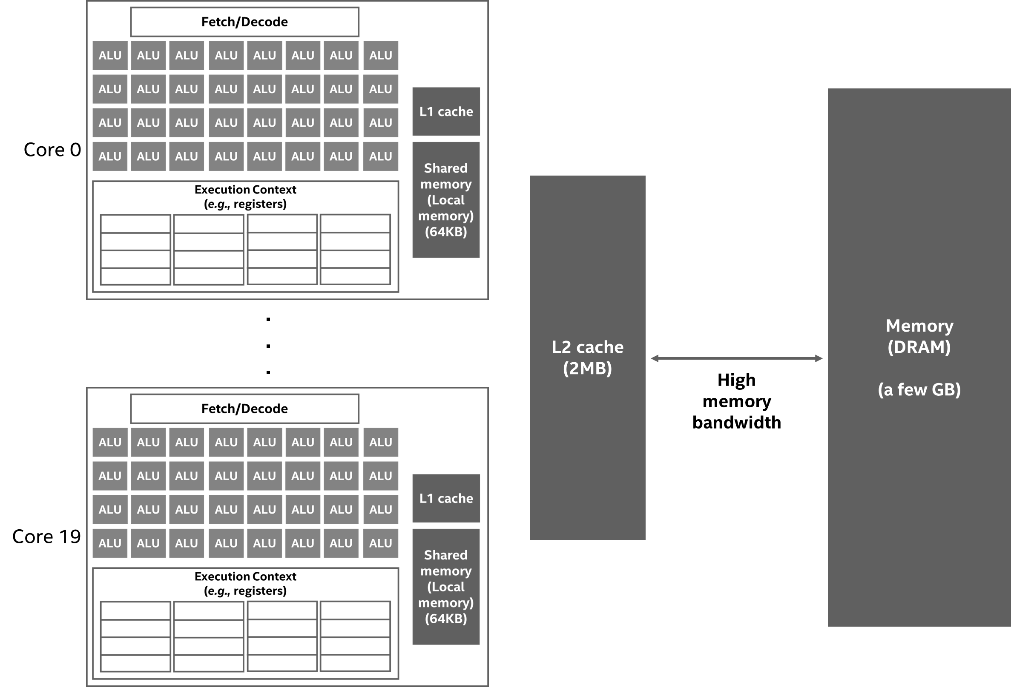
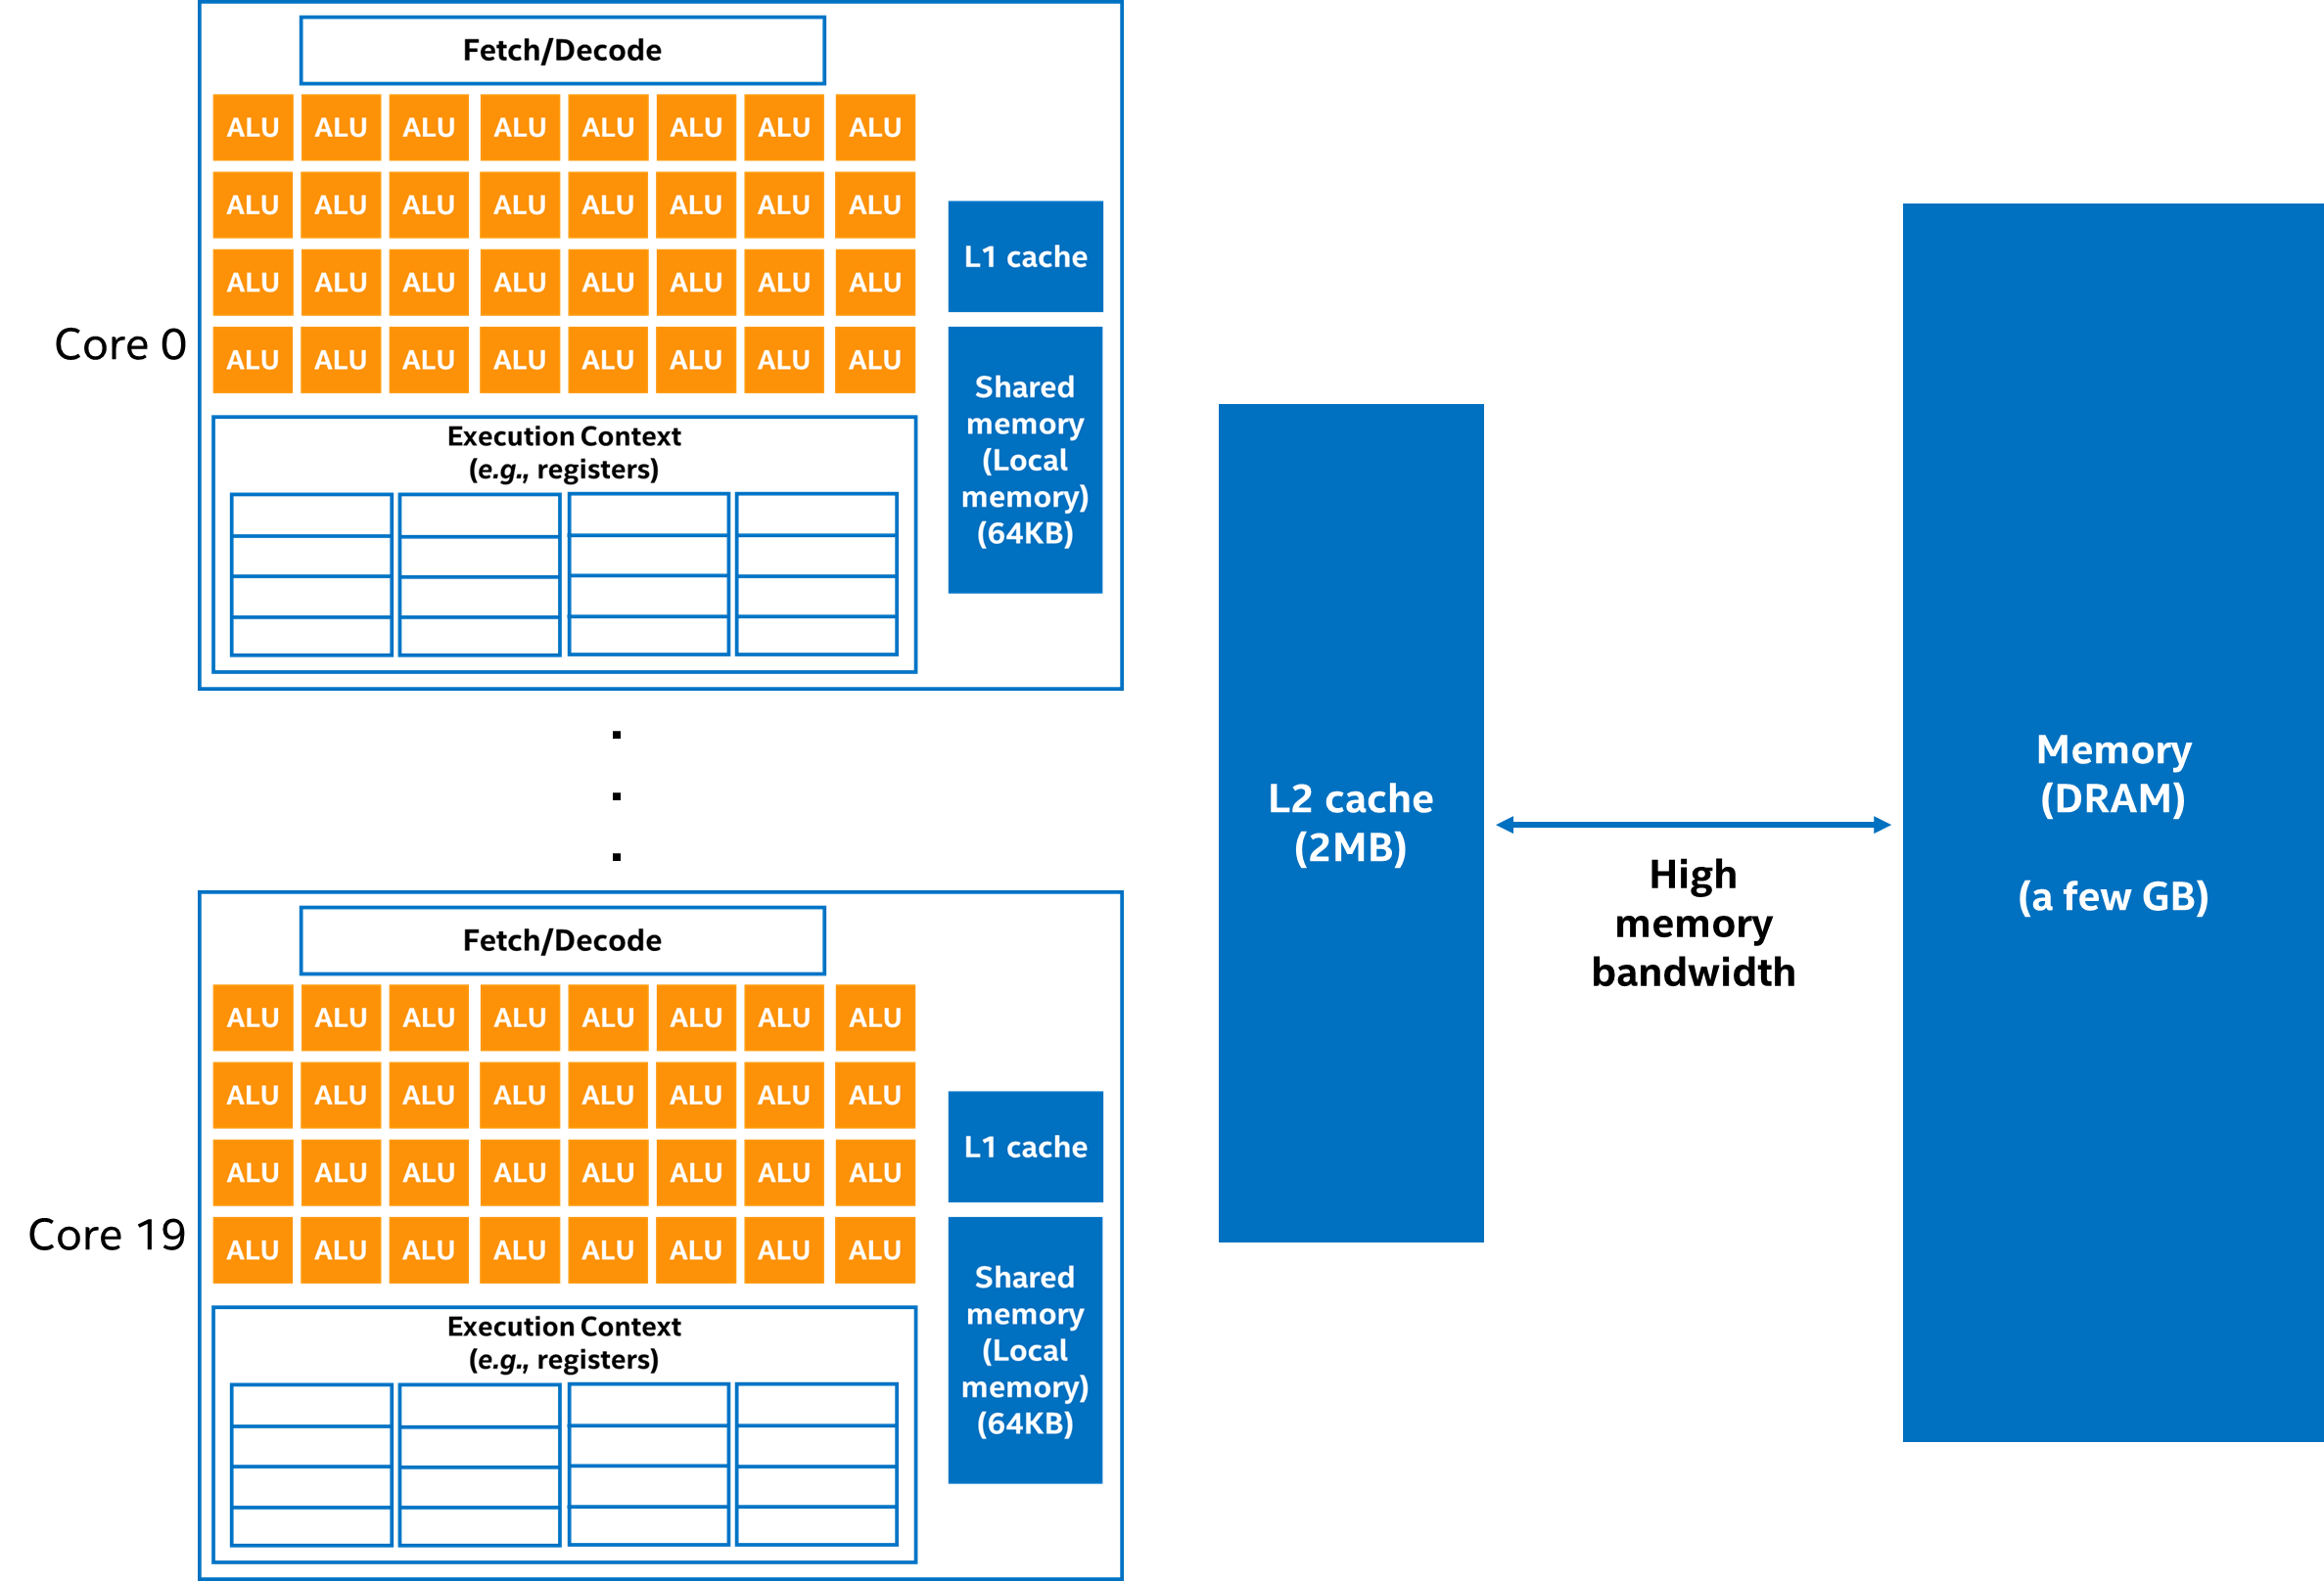
GPU Systems
More compute, less cache
Less cache per core
High latency, high throughput processors

Slide 160
Evaluation Methodology (GPU-bitap)
nvprof analysis on a real system
System Configuration:
Nvidia Titan V GPU (Volta)
80 multiprocessors * 64 CUDA cores per MP = 5120 CUDA cores
L2 cache size = 4.5MB
Warp size = 32
12GB HBM2 memory
Analysis Details:
Events:
Elapsed and active cycles
Metrics:
Branch and warp execution efficiency
L2 read/write transactions and throughput
DRAM read/write transactions and throughput
Stalls (i.e., instruction fetch, execution dependency, memory dependency, and busy compute pipeline)

Slide 161
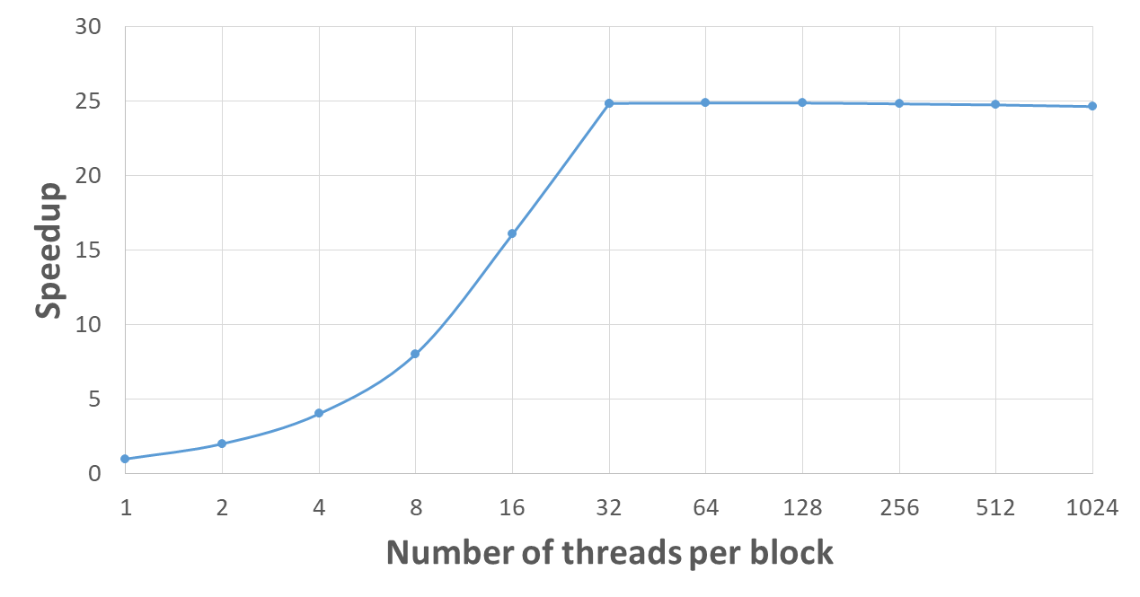
Results (GPU-bitap)
Compute-bound
Shared cache-bound

Slide 162
Results (GPU-bitap)
From 1 thread per block to 32 threads per block,
GPU-bitap is compute-bound, and
Warp execution efficiency increases from 3% to 100%, linearly.
GPU-bitap is shared cache-bound (i.e., on-GPU L2 cache-bound) after number of threads per block reaches 32.
Small number of registers → not enough to hold the frequently used data
Number of L2 read transactions stops decreasing and becomes stable
Bottlenecks:
Shared memory and L2 cache accesses
Destructive interference of threads

Slide 163
Example for the Bitap Algorithm

Slide 164
GenASM Algorithm
GenASM-DC Algorithm:
Modified Bitap for Distance Calculation
Extended for efficient long read support
Besides bit-parallelism that Bitap has, extended for parallelism:
Loop unrolling
Text-level parallelism
GenASM-TB Algorithm:
Novel Bitap-compatible TraceBack algorithm
Walks through the intermediate bitvectors (match, deletion, substitution, insertion) generated by GenASM-DC
Follows a divide-and-conquer approach to decrease the memory footprint
Notes:
[CLICK] Our first algorithm GenASM-DC
[CLICK] is the modified Bitap algorithm for distance calculation, where
[CLICK] we extend it to provide efficient support for long reads, and
[CLICK] we enable parallelism besides bit-parallelism that baseline Bitap provides by
[CLICK] performing loop unrolling and removing the loop dependencies and
[CLICK] exploiting text-level parallelism, where we divide the text into overlapping sub-texts and search the query in each of these sub-texts in parallel.
[CLICK] Our second algorithm, GenASM-TB, is a novel Bitap-compatible traceback algorithm,.
[CLICK] which walks through the intermediate bitvectors (match, deletion, substitution, insertion) generated by GenASM-DC and finds the optimal alignment.
[CLICK] In order to decrease the memory footprint of the algorithm, it follows a divide-and-conquer approach, where we divide the text and pattern into overlapping windows and perform the traceback computation for each window. After all of the windows’ partial traceback outputs are generated, we merge them to find the complete traceback output.

Slide 165
Loop Unrolling in GenASM-DC

Slide 166
Traceback Example with GenASM-TB

Slide 167
GenASM [MICRO 2020]
Damla Senol Cali, Gurpreet S. Kalsi, Zulal Bingol, Can Firtina, Lavanya Subramanian, Jeremie S. Kim, Rachata Ausavarungnirun, Mohammed Alser, Juan Gomez-Luna, Amirali Boroumand, Anant Nori, Allison Scibisz, Sreenivas Subramoney, Can Alkan, Saugata Ghose, and Onur Mutlu,
"GenASM: A High-Performance, Low-Power Approximate String Matching Acceleration Framework for Genome Sequence Analysis”
Proceedings of the 53rd International Symposium on Microarchitecture (MICRO), Virtual, October 2020.
Notes:
GenASM will appear in MICRO 2020 next week and you can find our pre-print online.

Slide 168
Backup Slides (BitMAc)

Slide 169
Intel Stratix 10 MX
Notes:
***

Slide 170
BitMAc Design
Notes:
In BitMAc, we map our GenASM accelerators and their associated SRAMs (See Section 4.7) to the Intel Stratix 10 MX device. As we show in Figure 5-2, we map the DC and TB datapaths along with the HBM2 interface to the FPGA core logic fabric. Due to their larger total capacity, we map TB-SRAMs to the M20Ks. On the other hand, since DC-SRAM is required only to store the input text and pattern, we store them into registers and thus, map them to the core logic fabric as well.

Slide 171
BitMAc – Results
Notes:
***

Slide 172
BitMAc – Results
Notes:
***

Slide 173
BitMAc – Results
Notes:
***

Slide 174
Backup Slides (SeGraM)

Slide 175
SeGraM – Graph Structure
Notes:
1.4 GB in total
620 MB nodes
740 MB chars
106 MB edges
We use the stats (i.e., number of nodes, number of edges and total sequence length) for each chromosome’s associated graph to determine the data sizes of our graph structure. Based on our analysis, we find that each node in the nodes table requires 32B per entry and the total size of the nodes table is #nodes * 32B. Since we can store characters in the sequences table using a 2-bit representation (since we only have 4 possible characters), the total size is total sequence length * 2bit. We also find that each entry in the edges table requires 4B, thus the total size of the edges table is #edges * 4B.
we use three separate table structures: (1) the nodes table, which stores the nodes of the graphs as the <node id> as the key and the <node’s sequence’s length, starting address at the sequences table, node’s number of outgoing edges, starting address at the edges table> as the value; (2) the sequences table, which stores the associated sequences of each node; and (3) the edges table, which stores the associated outgoing nodes (by node ID) of each node.

Slide 176
SeGraM – Index Structure
Notes:
9.8GB in total
In the first-level of the hash table, similar to Minimap2 [136], we have buckets to decrease the memory footprint of the index. Each entry in this first-level of the index stores <starting address of the minimizers in the corresponding bucket in the second-level, number of minimizers in the corresponding bucket>. In the second-level of the hash table, we have the minimizers. Each entry in this second-level of the index stores <hash value of the corresponding minimizer, starting address of the seed locations of the corresponding minimizer in the second-level, number of locations of the corresponding minimizer>. Minimizers are sorted based on their hash values in the second-level of the index. Finally, in the third-level of the hash table, we have the seed locations. Each entry in this third-level of the index stores <node ID of the corresponding seed location, relative offset of the corresponding seed location within the node>. Locations are grouped based on their corresponding minimizers and sorted within each group based on their values.
We use the stats (i.e., number of distinct minimizers, total number of locations, maximum number of minimizers per bucket, and maximum number of locations per minimizer) for each graph to determine the data sizes of our index structure. Based on our empirical analysis, we find that 224 is the optimum number of buckets in terms of memory footprint and the number of keys per each bucket. We also find that each bucket entry requires 4B of data, thus the total size of the first-level of the index is 224 * 4B. Each minimizer in the second-level of the index requires 12B of data, thus the total size of the second-level of the index is #distinct minimizers * 12B. Each location in the third-level of the index requires 8B of data, thus the total size of the third-level of the index is #total number of locations * 8B.

Slide 177
Minimizers
Notes:
***

Slide 178
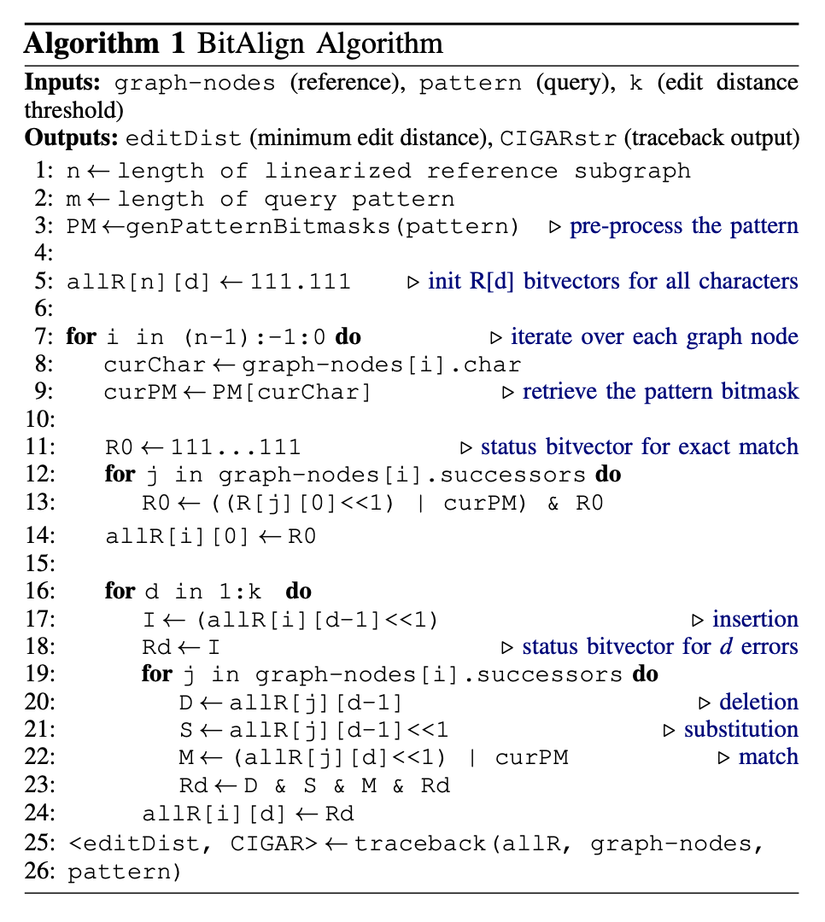
BitAlign Algorithm

Slide 179
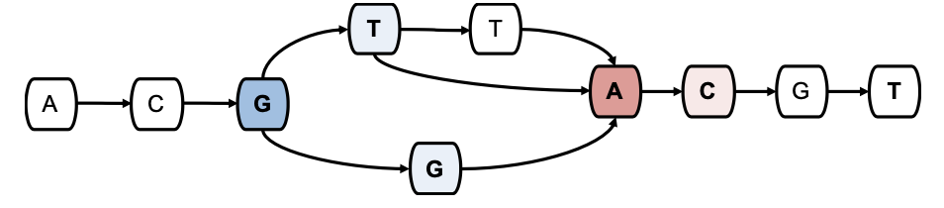
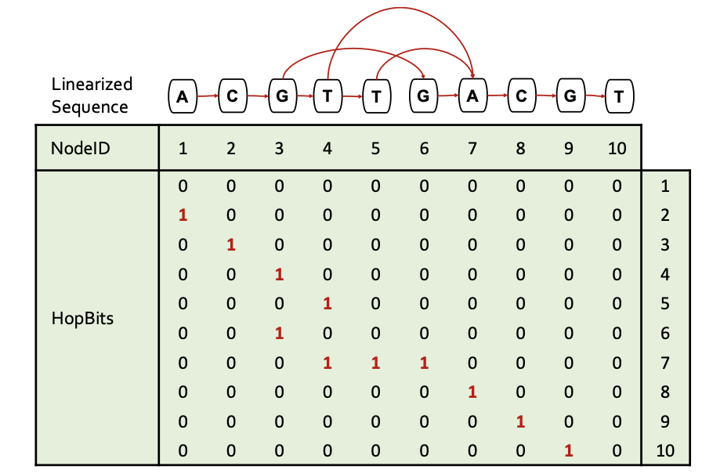
SeGraM – Hops
Notes:
***

Slide 180
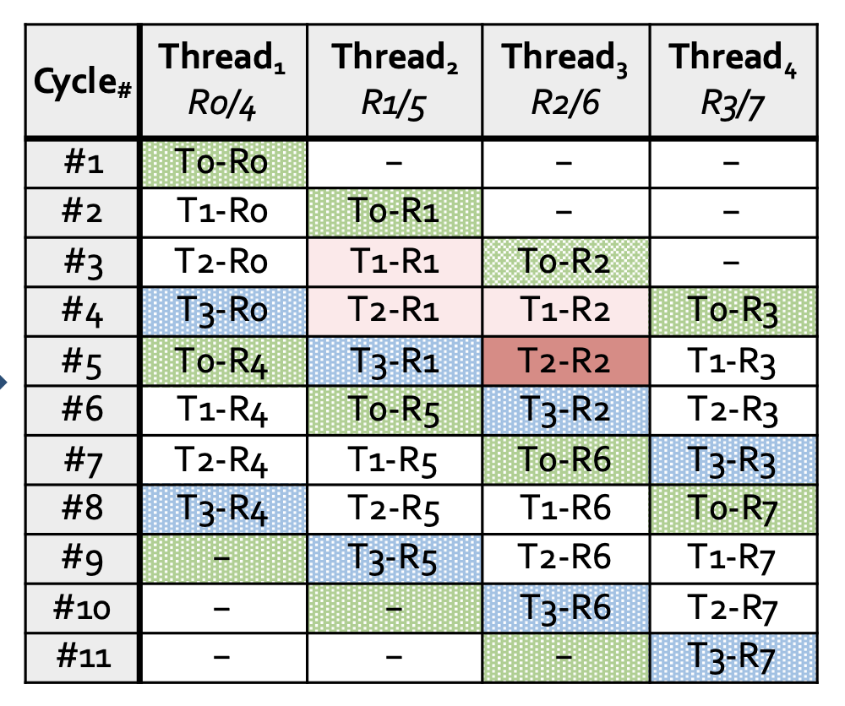
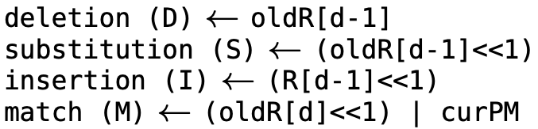
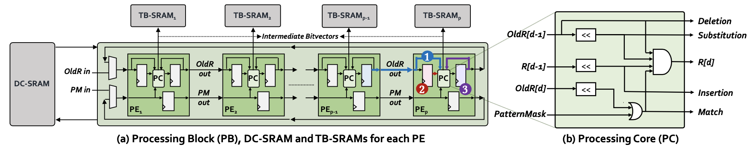
Recall: GenASM-DC’s HW Design
Notes:
(1) T2–R1 (which maps to R[d – 1]) needs to be generated by PE(x–1) in Cycle(y–1)
(2) T1–R1 (which maps to oldR[d – 1]) needs to be generated by PE(x–1) in Cycle(y–2)
(3) T1–R2 (which maps to oldR[d]) needs to be generated by PE(x) in Cycle(y–1)

Slide 181
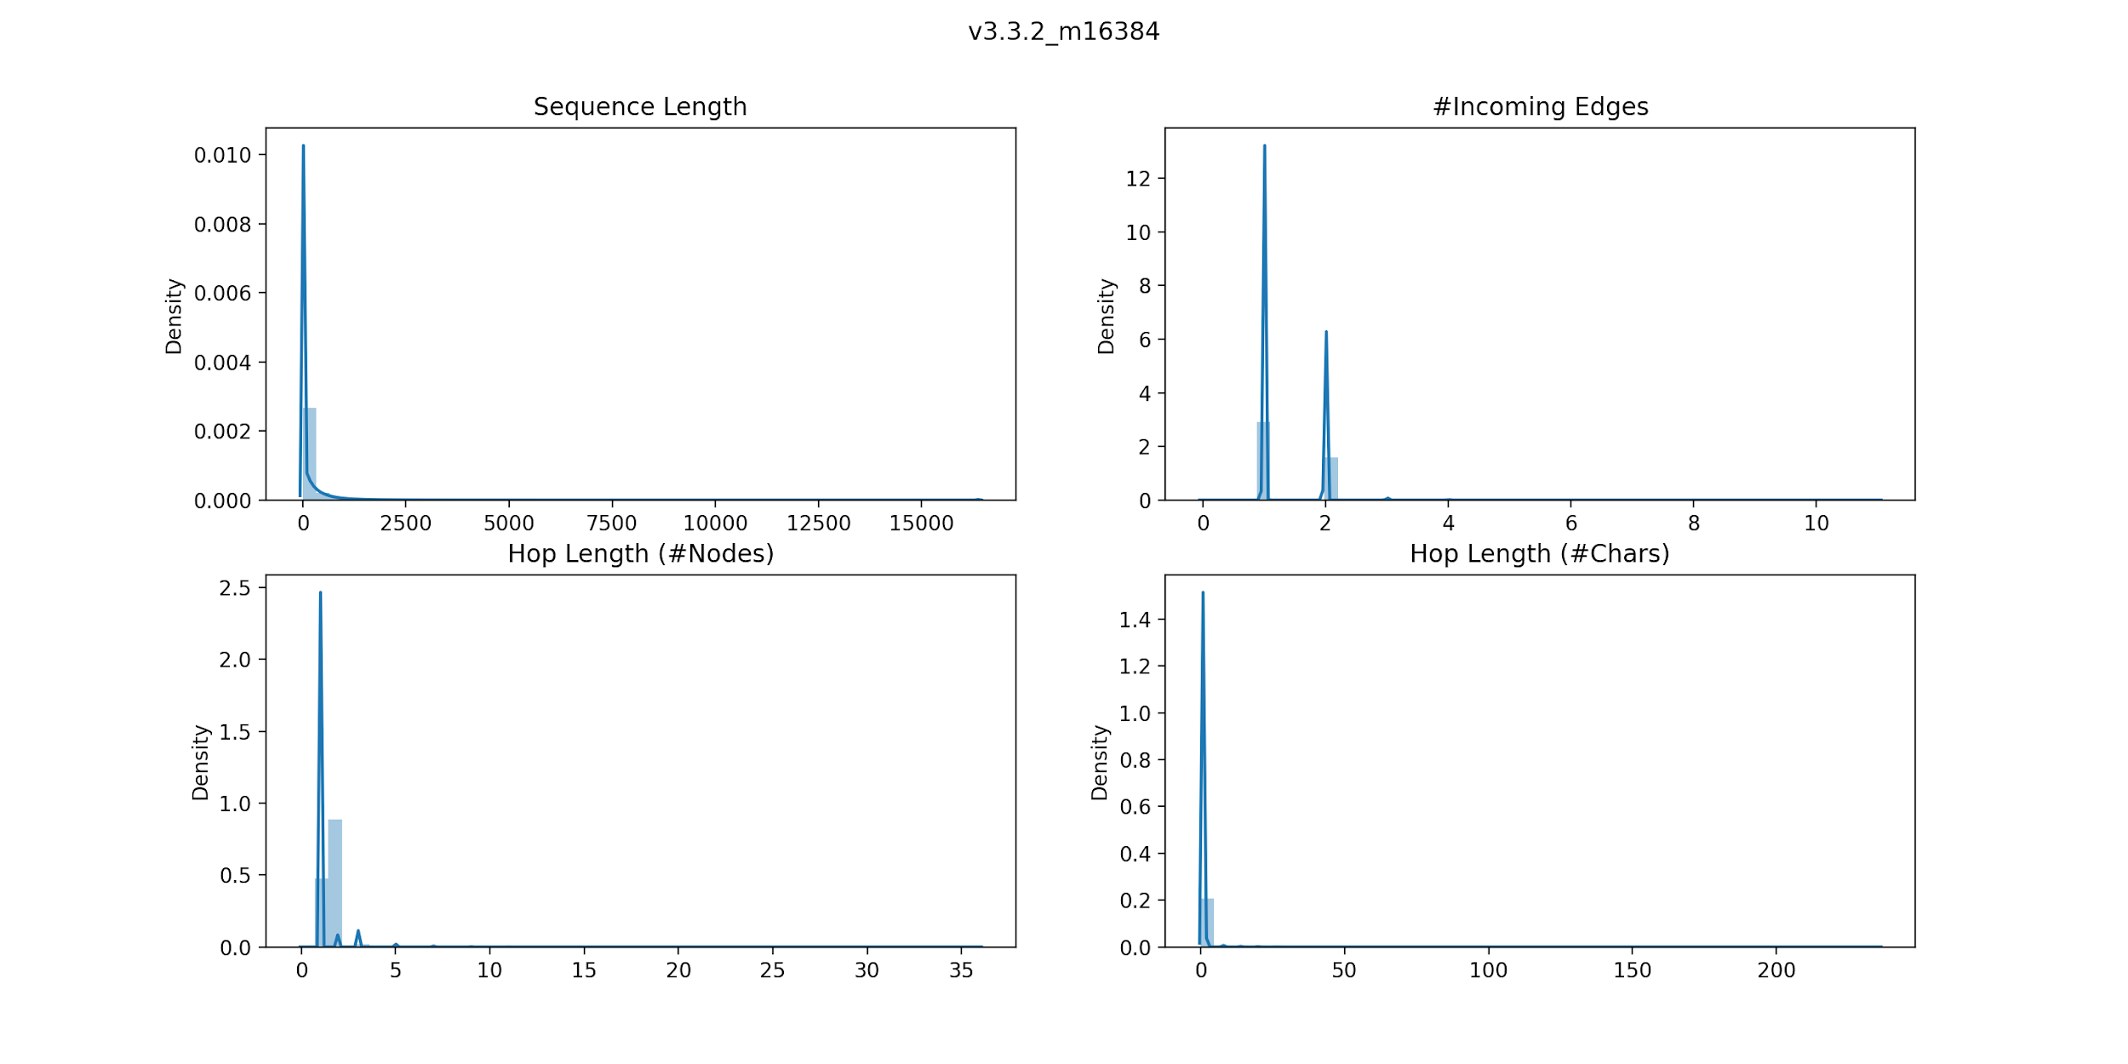
BitAlign – Hop Length Dist Plots

Slide 182
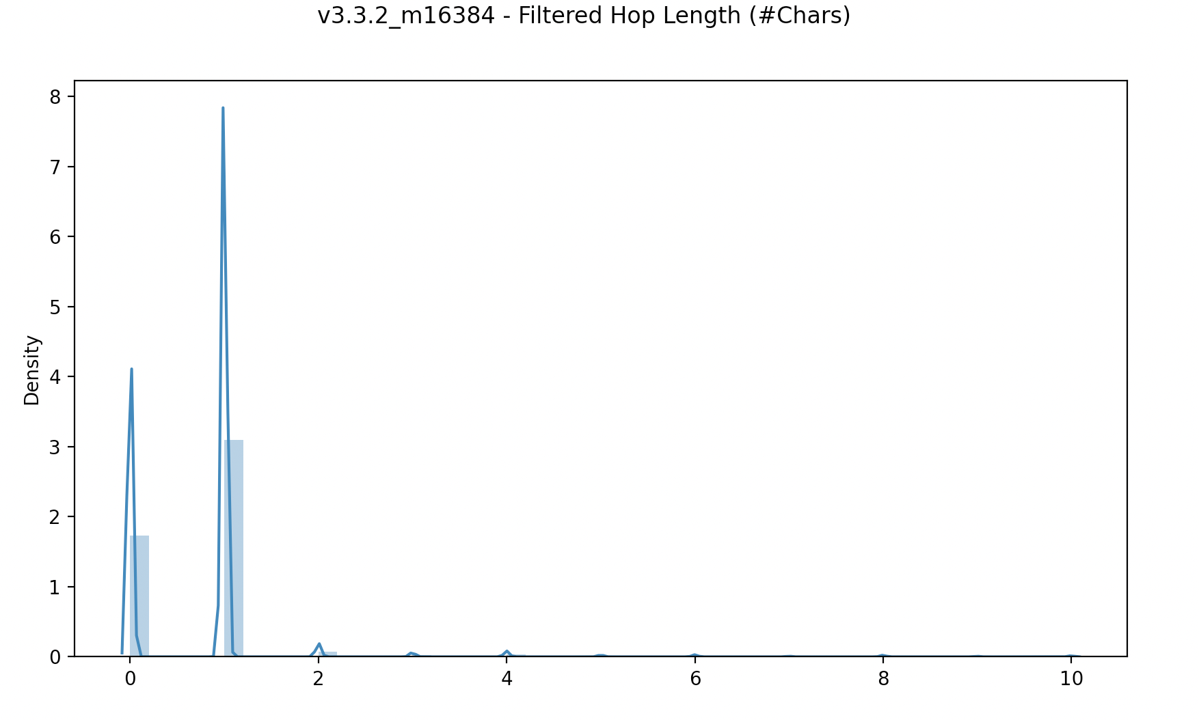
Hop Length Dist Plots (cont’d.)

Slide 183
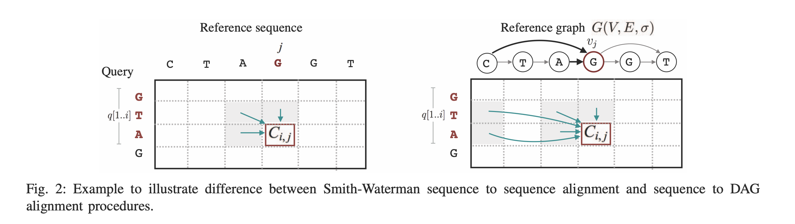
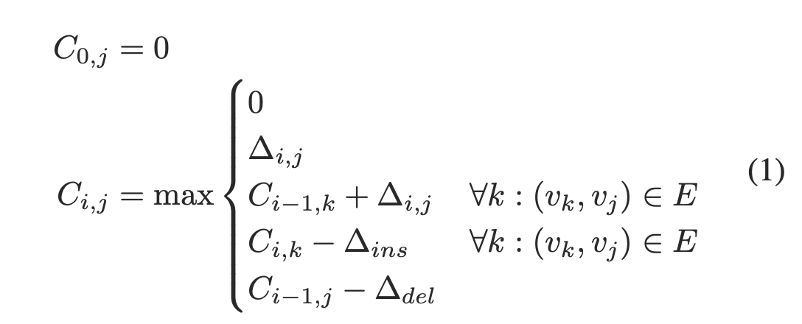
DP-based Graph Alignment
From PaSGAL paper

Slide 184
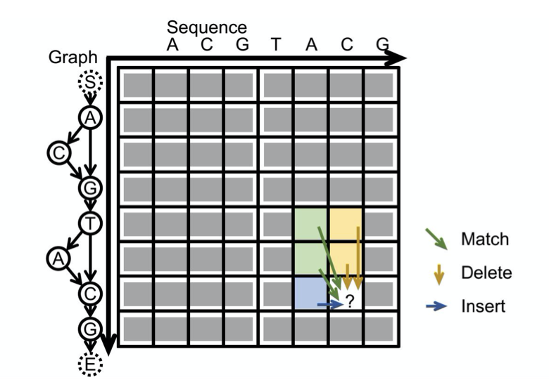
DP-based Graph Alignment (cont’d.)
“abPOA processes all the vectors in a row-by-row manner following the partial order of the graph. During the DP process, for “match” and “delete” operations (diagonal and vertical moves in the DP matrix), all scores stored in each SIMD vector can be updated in parallel as they only rely on scores in the predecessor rows. For “insert” operations (horizontal moves in the DP matrix), sequential non-parallel updating of scores in the same SIMD vector is needed, as the score of each cell depends on the score of the cell on the left.”
From abPOA paper

Slide 185
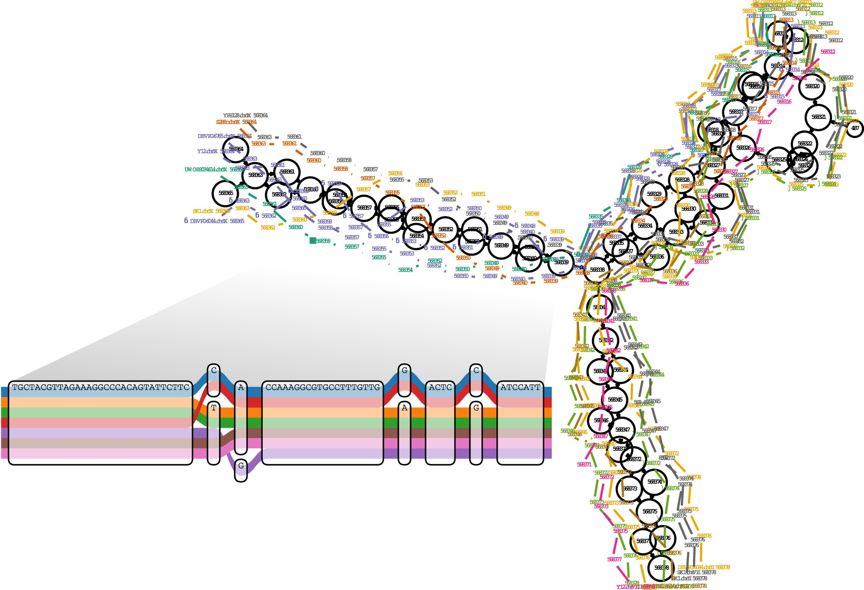
“A region of a yeast genome variation graph”
from vg paper [Garrison et al., Nature Biotechnology, 2018]

